Slide 1


Gestión de infraestructura y soberanía digital:
Una sola forma de gestionar tu infraestructura, tus datos y tu IA — estén donde estén
Manuel Abellán (Microsoft)​
​Carlos Alonso (Microsoft)​
Josep Sánchez (Nunsys Group)

Slide 2
01
02
03
04
Gestión de infraestructura
Soveranía digital
Marco de contratación
Nunsys
Agenda
Notes:
Y si ARC gestiona vuestra infra este donde este, Azure local es el siguiente paso:
Es azure con todas sius capacidades corriendo en vuestro hardware, en vuestro CPD. Y gracias a ARC con el mismo panel de control
Conectado si es necesario o totalmente aislado (sin internet) si el dato es ultra-sensible o por exigencies regulatorias.

Slide 3
Gestión de infraestructura

Slide 4
Microsoft Azure
Plano de control único con Azure Arc
Conecta y gestiona recursos híbridos como si fueran recursos nativos de Azure
Azure Arc-enabled infrastructure
Implementar y ejecutar servicios de Azure fuera de Azure sin dejar de gestionarlos desde Azure
Azure Arc-enabled services
Infrastructure
Services
Servers
K8s
Windows Server
SQL
Server
Linux
Microsoft Copilot
in Azure
Microsoft
Defender
for Cloud
Azure Monitor
Azure Update Manager
Azure Policy
Multi-cloud
Datacenter
Edge
Notes:
Entendiendo la naturaleza hibrida de los sistemas en las universidades.
ARC ofrece un único panel para todo: CPD, clusteres, Infra local, otras nubes...
Donde unifica, no solo su visivilidad, sino tambien sus controles
¿Y que controles?

Slide 5






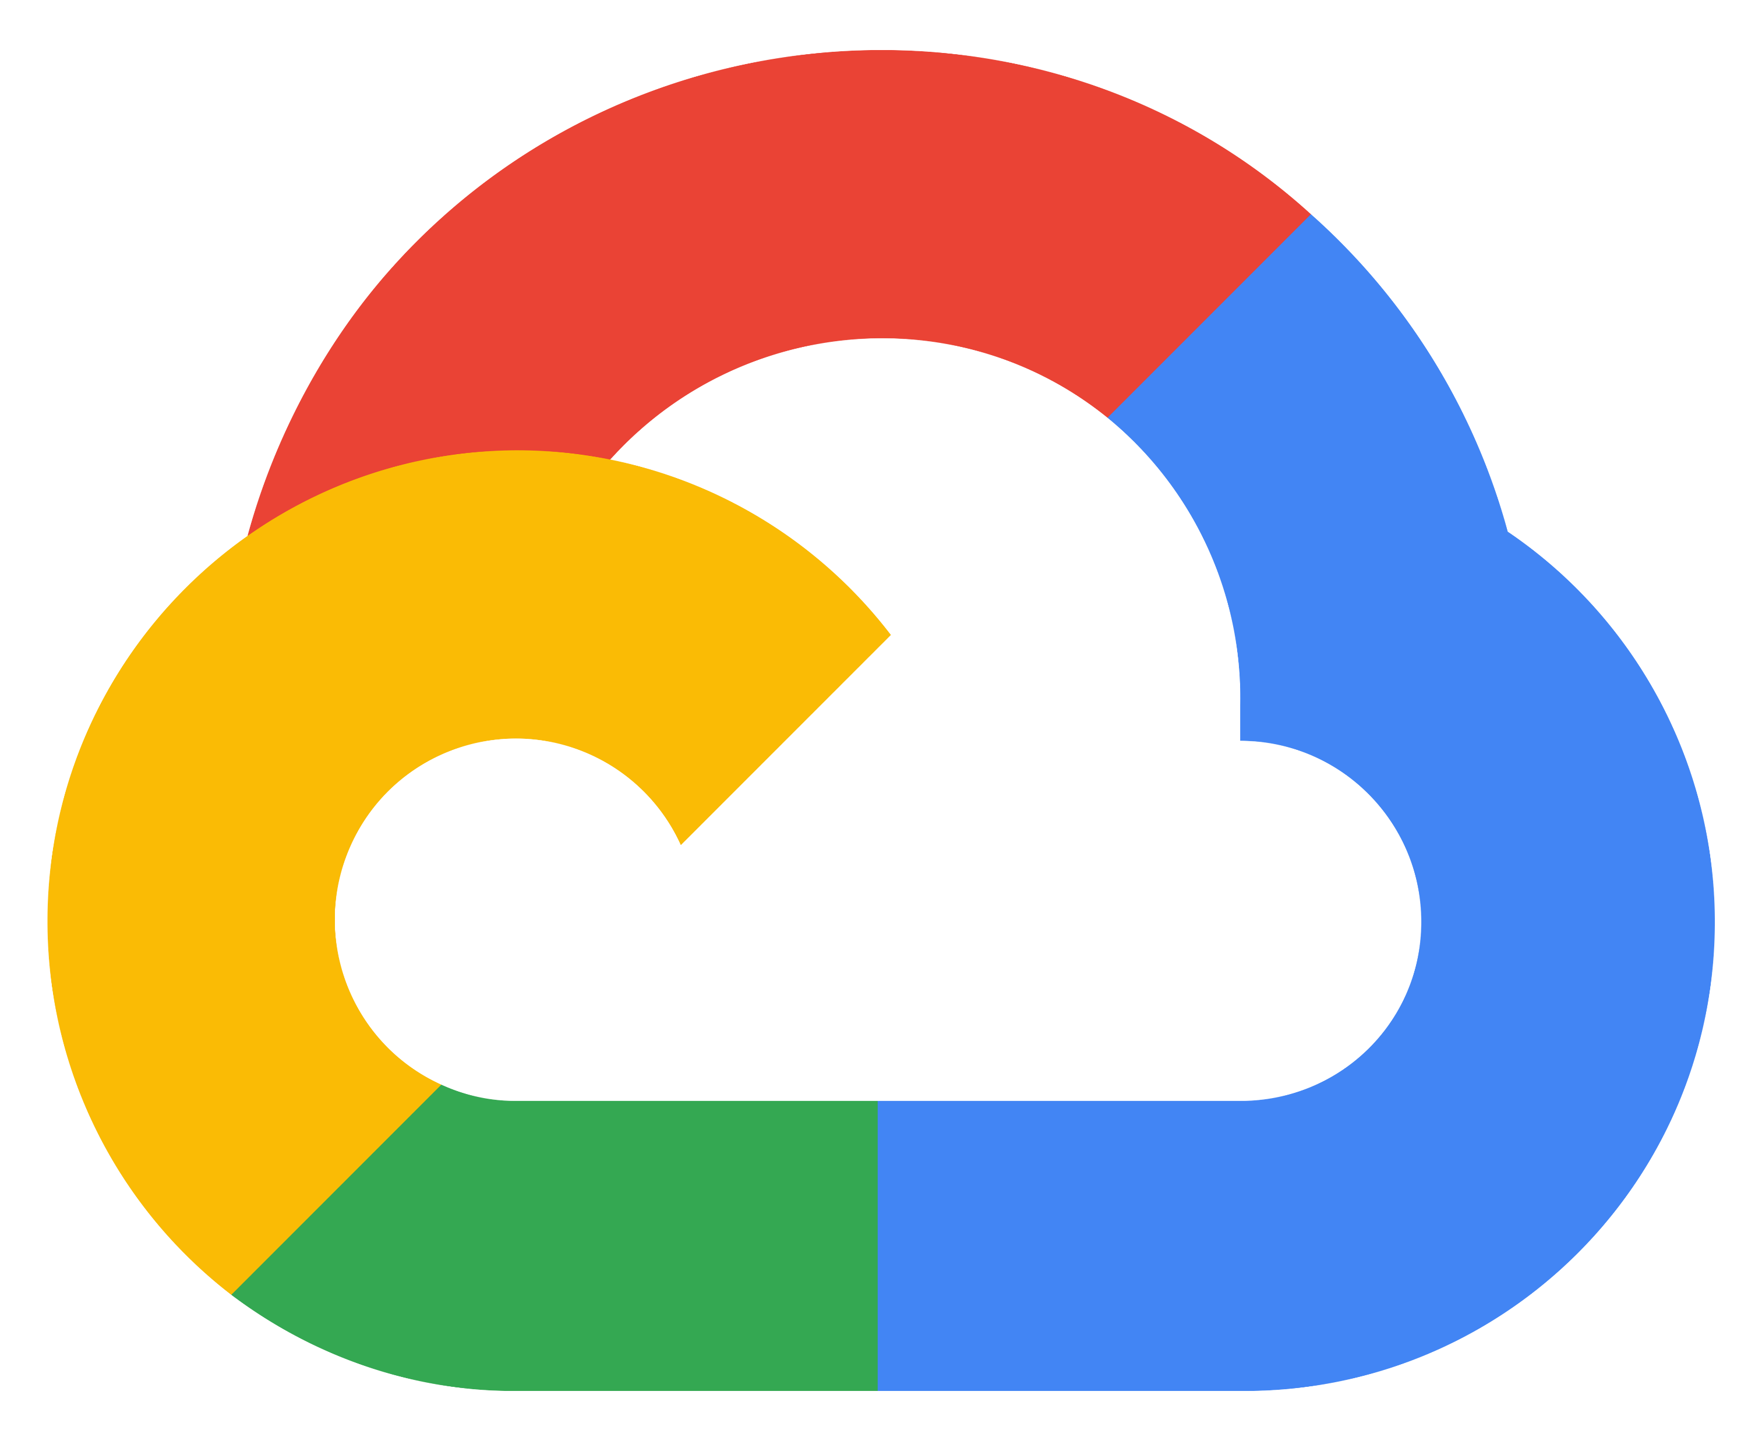

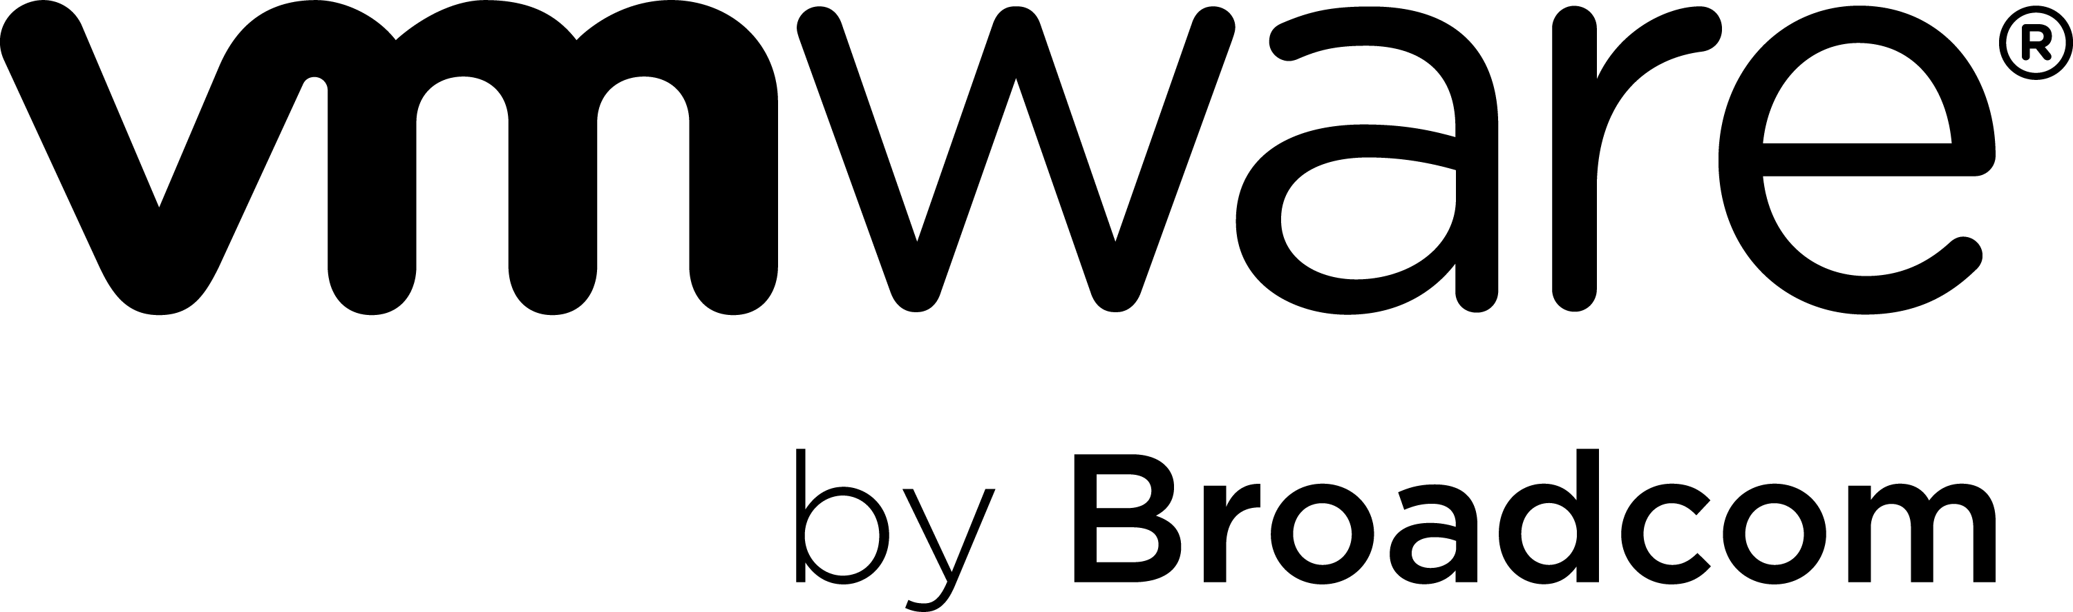

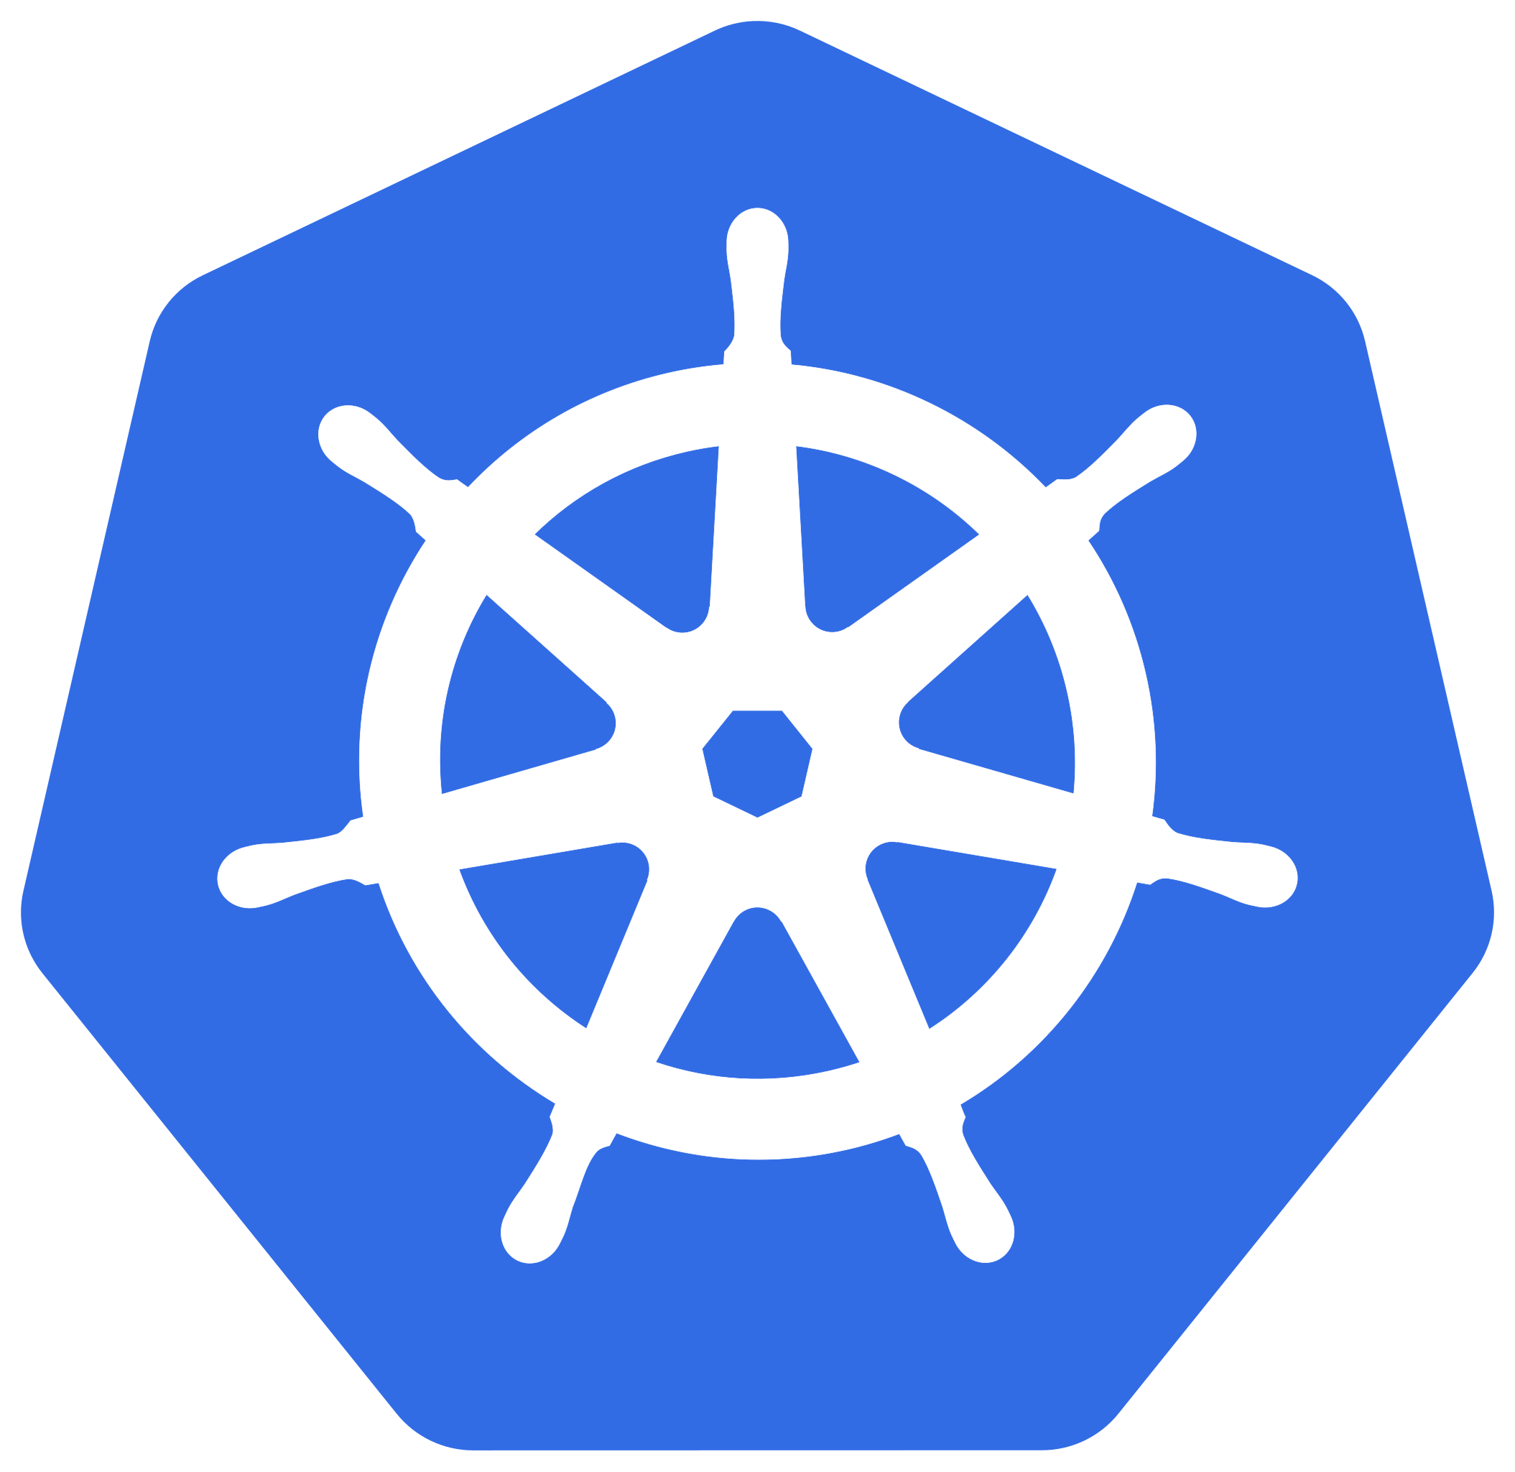



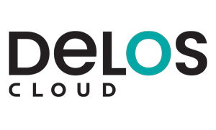

Plataforma coherente de gestión y desarrollo de infraestructuras
Enabled by Azure Arc
Gestión de la configuración
y gobernanza
Resiliencia y observabilidad
Seguridad y control integrados
Asistente de Al, portal y herramientas
Azure Monitor
Copilot
in Azure
Azure Update Manager
Configuration Management
Azure
Policy
Inventory Management
Microsoft Defender
for Cloud
Chaos
Studio
Site
Recovery
Azure
Portal
Powershell and CLI
Azure Services across your infrastructure
Azure
Multi-cloud
On-premises
Azure Local
Microsoft Hyper-V
Notes:
Los 3 Sueperpoderes de ARC:
Visibilidad gratis y control gobierno y seguridad con coste
Gobernar: Mismas políticas, inventario y cumplimiento en todos los entornos Azure Policy, Machine Config
Asegurar: Misma seguridad y visibilidad en on-prem, cloud y edge Defender for Cloud, Sentinel
Operar: Parches, monitorización y automatización centralizados Azure Monitor, Update Manager
Frase resumen: Implementa un inventario, gestión, gobernanza y seguridad coherentes para los servidores de todo tu entorno.
¿Y como funciona esto?

Slide 6
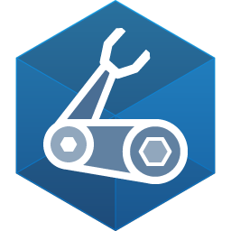
How it works ?/ Under the hood
Azure Portal
CLI
Infra as Code
PowerShell
Azure Resource Manager
Inventario y organización
Gestión de la configuración
Azure Resource Graph
Management Groups
Resource Groups
Service
Groups
Tags
Azure Update Manager
Machine Configuration
Azure
Policy
Seguridad y observabilidad
Infraestructura como código y despliegues
Microsoft Entra ID
Microsoft
Defender
Microsoft
Sentinel
Azure Monitor
Bicep Templates
Azure Template Specs
Deployment Stacks
Servicios de operaciones y gestión
Azure Arc
Managed Servers, Kubernetes & Serverless Containers anywhere
Public Cloud
Hybrid Cloud
Multi-cloud
Edge
IoT
Notes:
Abajo (la base) → tus recursos, estén donde estén: servidores, Kubernetes, contenedores en Public / Hybrid / Multi-cloud / Edge / IoT.
Azure Arc → el puente: conecta esa base y la sube a Azure.
"Azure Resource Manager" → el plano de control: a partir de ahí Azure los trata como recursos nativos.
Los 4 cuadrantes → lo que ganas: inventariar/organizar · configurar/gobernar · asegurar · desplegar como código.
Arriba (Portal / CLI / IaC / PowerShell) → desde dónde lo manejas, da igual el entorno.

Slide 7

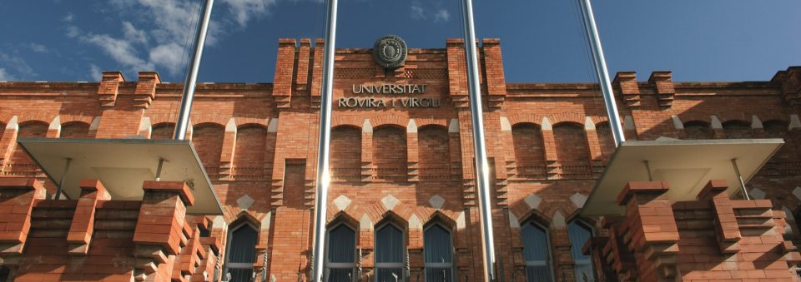

Customer:
Universidad Rovira i Virgili
Industry:
Education
Country:
Spain
Products and services:
Microsoft Azure Microsoft Azure Arc Microsoft Azure Automation Microsoft Update Management
Read full story here
La Universidad Rovira i Virgili mejora la gestión y la seguridad de su infraestructura híbrida, gracias a Azure Arc
““Nuestro objetivo era lograr una gestión centralizada de todos nuestros entornos, tanto cloud como on-premises, con la mayor compatibilidad posible y la máxima seguridad, protegiendo la inversión realizada en infraestructuras existentes”
– Jordi Duch Gavaldà, adjunto para las Tecnologías e la Información i la Comunicación de la URV
Entorno híbrido
Infraestructura ya desplegada
Gestión distribuida
Azure Arc
Gestión unificada
Seguridad y automatización
Unico plano de gestión
Mayor eficiencia operativa
Protegiendo inversión
Notes:
El reto (idéntico al de tu audiencia): al pasar a un modelo más híbrido, la URV se enfrentaba a administrar y gobernar entornos cada vez más complejos.
Qué hicieron: implantaron Azure Arc → unificaron en un solo sitio la gestión de todos sus recursos —cloud y on-premises—, ganaron seguridad y automatizaron tareas que antes hacían a mano.
El resultado clave: lograron gestión centralizada sin tirar nada — protegiendo la inversión en su infraestructura existente.

Slide 8
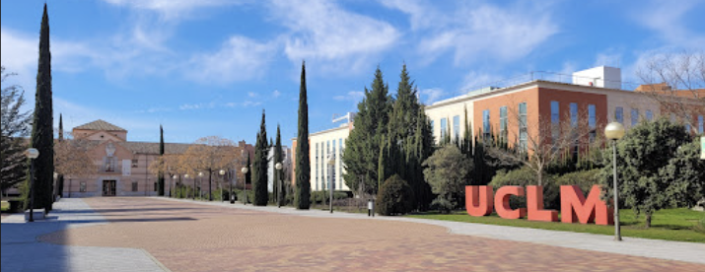

La Universidad de Castilla-La Mancha mejora la gestión y la seguridad de su infraestructura híbrida, gracias a Azure Arc, construyendo una base para estrategia multicloud y migración progresiva
Customer:
Universidad Castilla-La-Mancha
Industry:
Education
Country:
Spain
Products and services:
Microsoft Azure Microsoft Azure Arc Microsoft Azure Automation Microsoft Update Management
Read full story here
Entorno híbrido
Infraestructura ya desplegada
Gestión distribuida
Azure Arc
Gestión 60 VMs bajo mismo plano de control
Base para estrategia multicloud

Slide 9


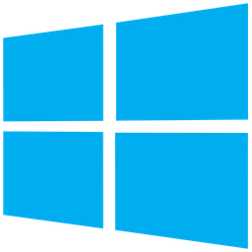

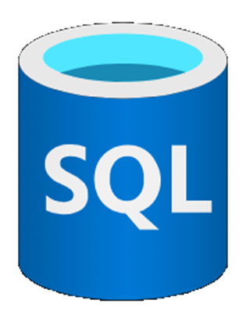
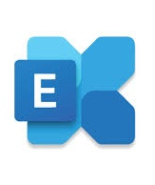
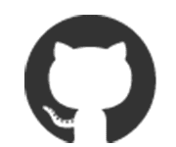


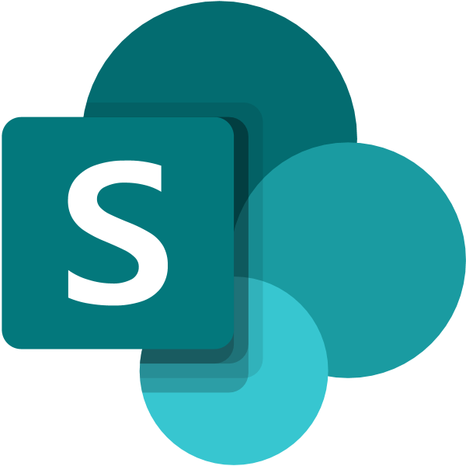
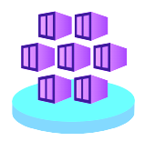
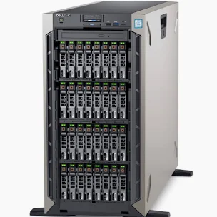
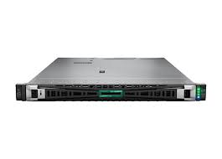
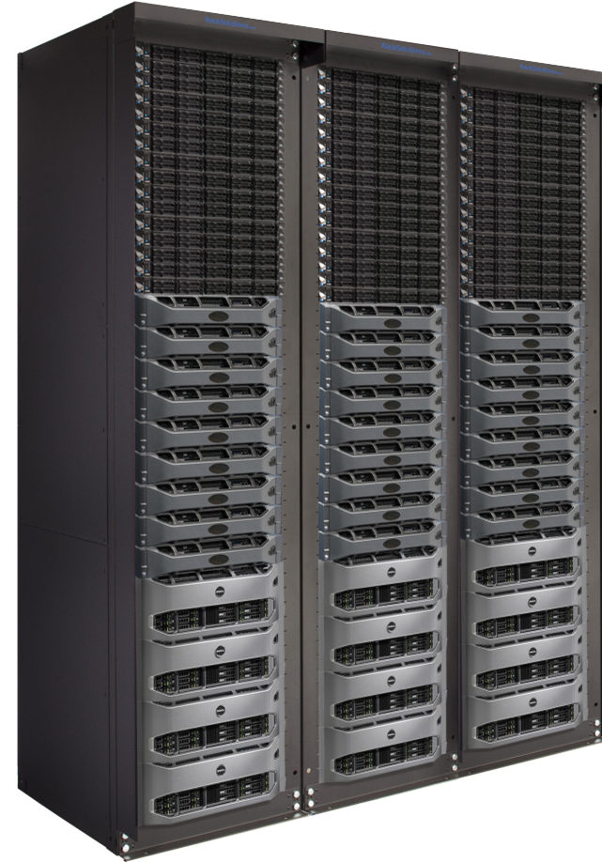
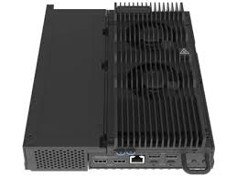
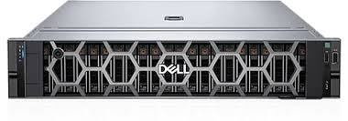
Azure Local
Azure Local overview
AI-ready infrastructure, anywhere
Connected to Azure region
Disconnected to Azure region
C
Any app
Defender for Cloud
Azure Monitor
Windows & Linux apps
Virtual apps
& desktops
Azure data
services
Microsoft 365 Local
GitHub Enterprise Local
Foundry Local
OSS AI Models
Frontier IP models*
Enabled by Azure Arc
Managed Kubernetes/AKS
General-Purpose VMs/IaaS
Core Infrastructure Services: Compute | Storage | Networking | Availability
Azure-based
Infrastructure
Management
Azure Local
Composable scale point for sovereign AI from
single nodes up to multiple racks clusters
* For qualified customers
Notes:
Y si ARC gestiona vuestra infra este donde este, Azure local es el siguiente paso:
Es azure con todas sius capacidades corriendo en vuestro hardware, en vuestro CPD. Y gracias a ARC con el mismo panel de control
Conectado si es necesario o totalmente aislado (sin internet) si el dato es ultra-sensible o por exigencies regulatorias.
+ la siguiente:
Las mismas familias de servicios —gestión y seguridad, aplicaciones, y datos e IA— están disponibles en la nube, en local conectado y en local desconectado
No reescribes nada ni cambias cómo lo gestionas — solo eliges dónde corre cada carga según lo que el dato te exija.

Slide 10







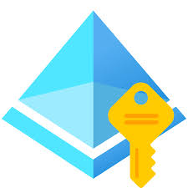
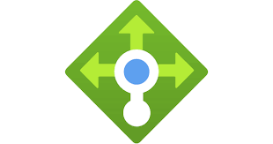

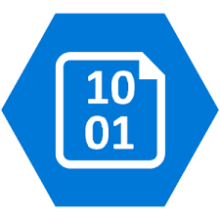
Bring Azure’s app, data, and AI services anywhere
Azure Local overview
Management & Security
Workloads & Applications
Data & AI
Portal CLI
Azure
Monitor
Update
Manager
Marketplace
Virtual
Machines
Kubernetes
Virtual
Desktop
SQL
PostgreSQL
Databricks
Cosmos
DB
Policy
Entra ID
Copilot
Firewall
Virtual Machine
Scale Sets
Migrate
API Mgmt
AI
Foundry
AI Agent
Services
OpenAI
AI Bot
Service
Azure
services,
tools
Cost
Mgmt
Key
Vault
Defender
Sentinel
Cloud
Load
Balancer
Gateway
Virtual
Network
Fire
Services
App
Services
Functions
Elastic
SAN
AI Content
Safety
AI Custom
Vision
AI Document
Intelligence
AI Face
Queue
Storage
Blob
Storage
Table
Storage
SLZ
Sovereign
Landing Zone
RedShift
OpenShift
Container
Apps
Container
Registry
AI Immersive
Reader
AI
Language
Machine
Learning
AI Search
Site
Recovery
Network
Security Groups
Express Route
Subnets
DevOps
Microsoft
365
Synapse
GitHub
Enterprise
AI Speech
AI Translator
AI Video
Indexer
Vision
Container
Backup
Log Analytics
Managed disks
Availability Zones
(Thousands of services and tools available in Azure regions and more still coming)
Subset of Azure services extended to the edge enabled by Azure Arc
Azure
Local
(connected)
Portal CLI
Azure
Monitor
Defender
Update
Manager
Copilot
Virtual
Machines
Kubernetes
Virtual
Desktop
Migrate
SQL
Edge RAG
Machine
Learning
Foundry
Local
Policy
Entra ID
Sentinel
Logical
Network
Key
Vault
IoT
Operations
Microsoft
365 Local
GitHub
Enterprise Local*
AI
Language
AI Content
Safety
AI Document
Intelligence
AI Local
Search
Backup
Site Recovery
Virtual Network*
Managed Identities
SLZ
Sovereign Private
Landing Zone*
Network
Security Groups
Software Load
Balancer*
External
SAN
Container
Apps
Skype for
business
Blob Block
Endpoints*
AI
Speech
AI Translator
AI Agent
Services*
AI Video
Indexer
On-Premises
Limited set of Azure services extended to disconnected edge
Azure
Local
(disconnected)
Portal CLI
3rd Party
Monitor**
Update
Manager
Key Vault
Virtual
Machines
Kubernetes
Virtual
Desktop**
Migrate*
Foundry
Local*
AI Agent
Services*
AI Content
Safety
AI Local
Search*
Software
Load Balancer*
Site
Recovery*
Resource
Manager
Logical
Network
External
SAN
Container
Registry
Skype for
Business
Blob Block
Endpoints*
Document
Intelligence
AI
Language
AI
Speech
AI
Translator
Policy
Managed Identities
Virtual
Network*
SLZ
Cloud to Edge
App Continuity*
IoT
Operations**
Microsoft
365 Local
Video Indexer*
Vision
Container
Azure Local delivers consistent Azure IaaS foundation to run CNCF-compliant 3P OSS anywhere
*Planned for CY26
** Future
Notes:
Las mismas familias de servicios —gestión y seguridad, aplicaciones, y datos e IA— están disponibles en la nube, en local conectado y en local desconectado
No reescribes nada ni cambias cómo lo gestionas — solo eliges dónde corre cada carga según lo que el dato te exija.

Slide 11

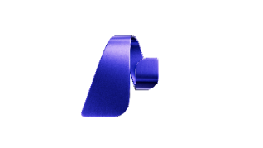
















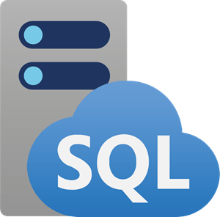
Anclar la IA con inteligencia empresarial en OneLake
Plataforma de Datos
Productividad
Microsoft
Fabric
IA y ML
M365
Copilot
Microsoft
Excel
Microsoft
Teams
Power
Platform
Azure
ML
Copilot Studio
Microsoft
Foundry
VS
Code
OneLake
Atajos Multi-cloud
Database
Mirroring
Google BigQuery
Cross Tenant
COSMOS
DB
SQL MI
Azure
AWS S3
GCP
Dataverse
Snowflake
Oracle
On-Prem
Databricks
SQLDB

Slide 12
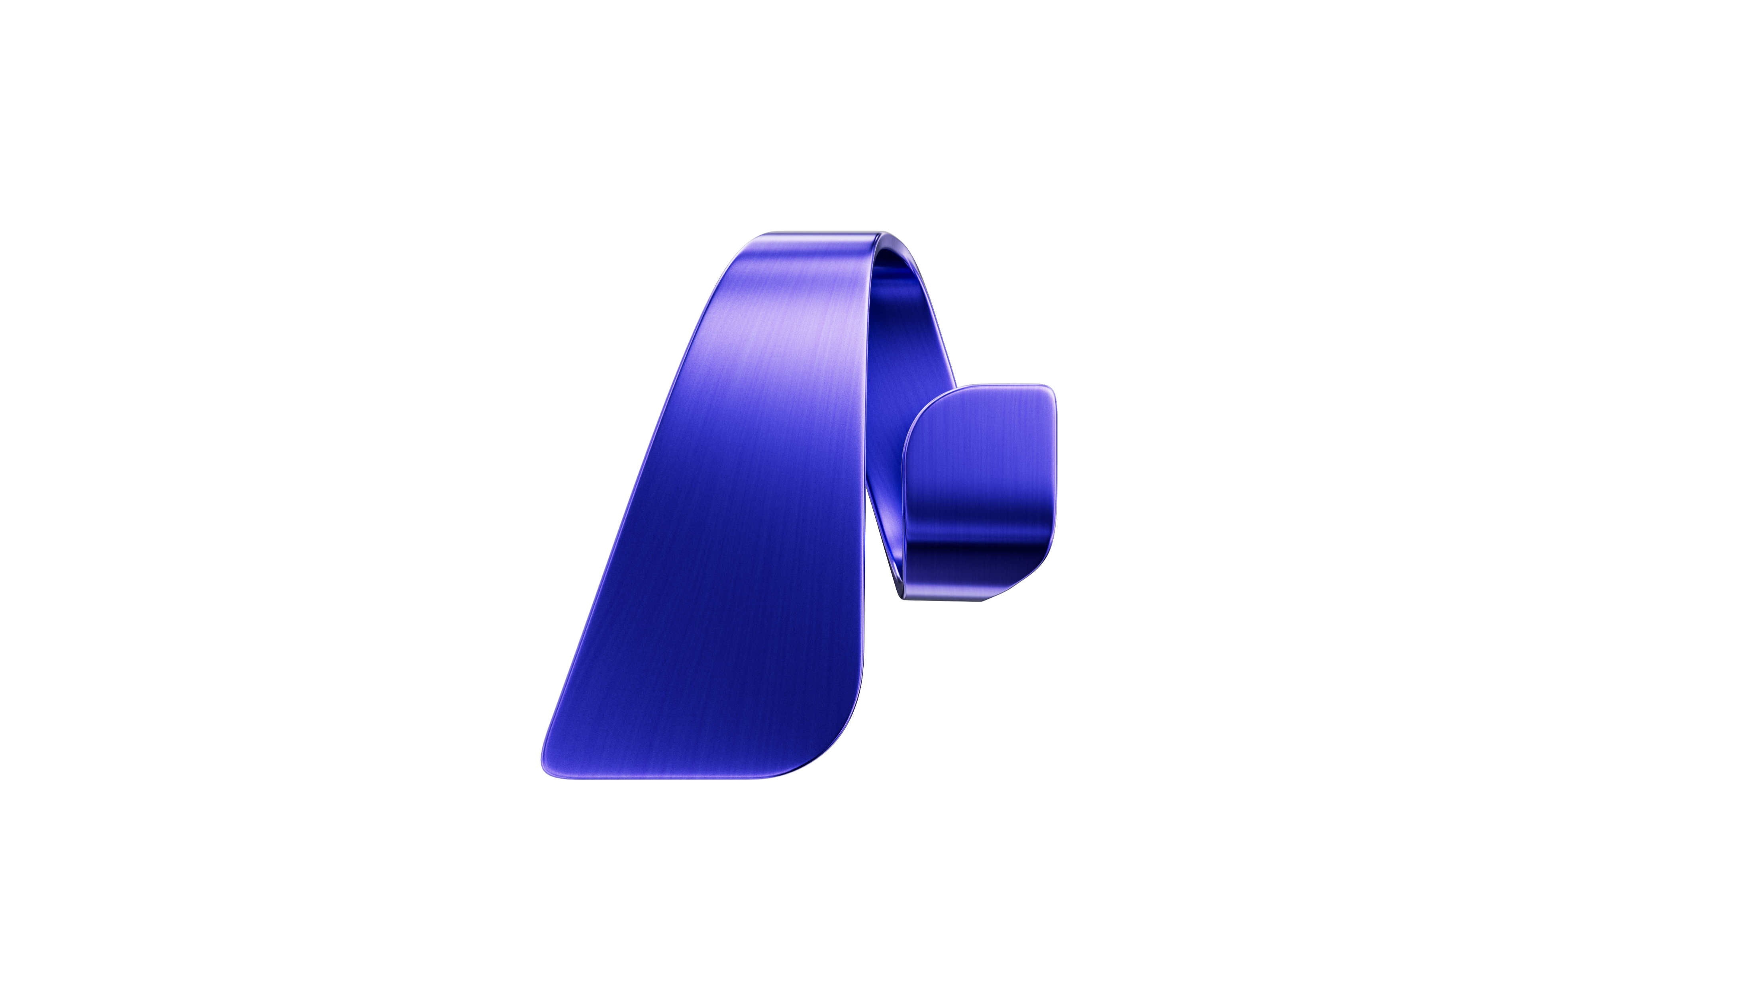


Microsoft Foundry abarca desde la nube hasta el edge
AI suite
NEW
Microsoft Foundry
Frontier models, agents
& fine-tuning hub
Foundry Local
Windows, MacOS, &
Android (Preview)
Foundry Local
on Azure Local
Models and inferencing on premises
Cloud
IoT, phones, laptops, desktops
Edge, hybrid, disconnected
Notes:
En el extremo izquierdo se ve Foundry en la nube, donde los modelos y servicios se ejecutan en la nube.
Pero en ocasiones disponemos de hardware para ejecutar estos modelos. Por eso presentamos Foundry Local en Build, para la ejecución de modelos de código abierto optimizados directamente en estos dispositivos personales.
Foundry Local uso en dispositivos periféricos, escenarios híbridos y escenarios aislados (airgapped).
No solo por la posibilidad de tener el hardware sino tambien por posibles necesidade de ejecutar procesos dentro de las instalaciones.
¿Y como esto es posible?

Slide 13




AI suite
Foundry Local for Azure Local
Plataforma de IA con modelos, agentes y herramientas para diseñar, personalizar y gestionar aplicaciones de IA en tu propio hardware.
Available
Roadmap
Descubre y desarrolla en la nube
Implementa y realiza inferencias en la nube privada soberana
Gobernanza y seguridad unificadas tanto en entornos conectados como desconectados
Models
IQ
Tools
Agents
Enabled by Azure Arc
Azure Local
AI optimized hardware – CPU, NPU, GPU
Create AI projects to connect services and data | Use common inferencing APIs for Foundry Models | Deploy AI apps to Azure Local using CI/CD pipelines
Notes:
Esto es posible gracias a que Foundry Local se ofrece en un contenedor orquestado por Kubernetes compatible con Arc y que se ejecuta en Azure Local,
Con esto Foundry abarca ahora desde la nube hasta el edge, llevando la IA exactamente donde la necesitas.
De momento solo la parte de modelos pero el resto de components estan en el roadmap asique la parte de IQ, las tools y el agent service pronto estarán disponibles también en local.

Slide 14

Foundry Local Models
AI suite
Models-as-a-Platform
(MaaP)
Customer managed
Brings the complete Foundry Local model catalog to Azure Local, enabling on‑premises inferencing across connected and disconnected scenarios, from single‑node to multi‑node deployments.
Many models.
Many use cases.
One platform.
Models-as-a-Service
(MaaS)
Flexible model selection
curated for Sovereign Private Cloud
Microsoft managed
Frontier models-as-a-service, hosts proprietary models on secured deployments of Azure Local accessible via APIs for inferencing on premises.
Notes:
"We're working to bring propriety ip models (e.g. Grok, OAI, Mistral, etc) to our customers with the most sensitive workloads where they cannot access to the cloud“​
We are partnering with biz dev , we do not have agreements, but we are working with model providers. ​
​
Our customers are
Geopolitical and sovereignty-driven model restrictions: A growing set of customers-particularly in Europe-are explicitly requesting EU-only LLMs, driven by geopolitical tensions, regulatory pressure, and concerns around foreign jurisdiction, extraterritorial access, and long-term strategic autonomy.
Model + platform packaging: Customers want access to high-value frontier/IP models under additional guardrails, while also wanting broad availability of “standard” models through a curated local catalog.
Sovereignty & disconnection constraints: Many public sector, defense, and critical infrastructure customers require local or fully disconnected AI deployments on customer‑owned infrastructure, with Azure Local.

Slide 15






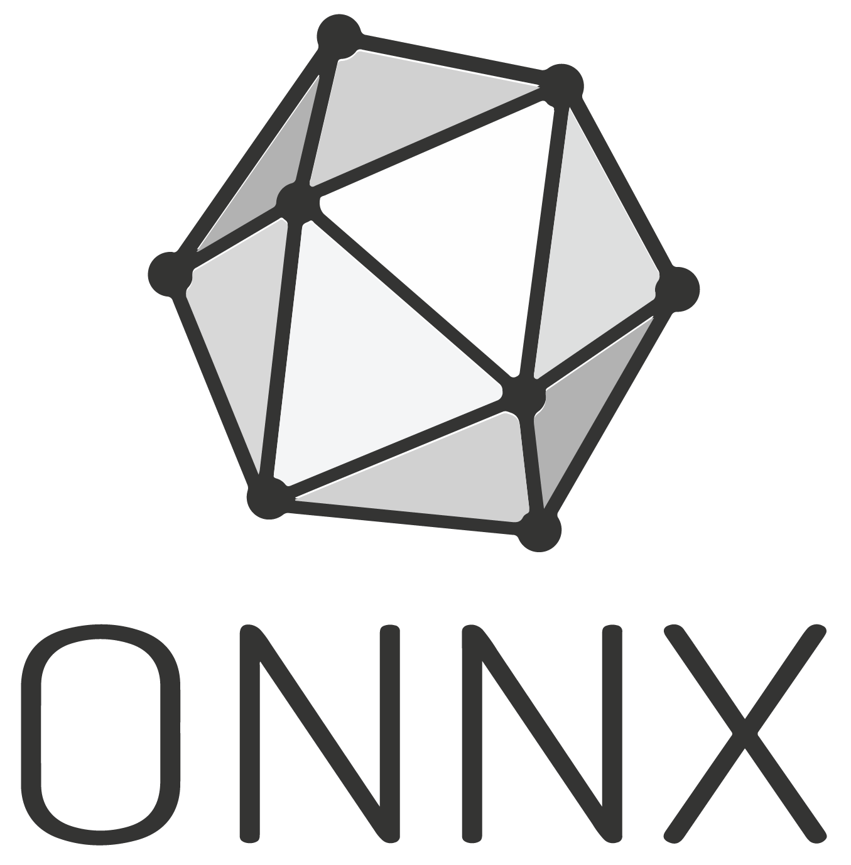
Foundry Local Model Offerings
AI suite
Models available as containers or through a Foundry Local enabled by Azure Arc validated on
Azure Local for all configurations, ranging from single-node to multi-node deployments.
Qualified customers
Bring your
own models
(e.g. Hugging face, custom predictive models)
OSS Models
Frontier Models
Qwen
Open AI
Mistral
DeepSeek
Microsoft
Open AI
Mistral
Model-as-a-Platform (Customer Managed)
Model-as-a-Service
Microsoft Managed
Dedicated API endpoints
vLLM
Arc-enabled Kubernetes
Distribute as Kubernetes apps
Azure Local
Notes:
Foundry Local gives customers a full spectrum of AI model options that all run locally—across connected, disconnected, and air‑gapped environments.
It supports generative models, predictive models, custom/enterprise models, and full BYO models, with a unified inferencing layer across CPU, GPU, and NPU.
Generative Models (LLMs / VLMs / SLMs)
Foundry Local supports generative AI models such as language models and multimodal models, running via ONNX or multi‑node vLLM‑based inference.
These models are packaged as containers and deployed through Azure Local or AKS‑Arc, enabling chat, reasoning, summarization, and agentic workflows locally.
For example: (Qwen, DeepSeek, Mistral*, etc.)
Talking point:
“This is our core GenAI layer—large and small models running completely inside the customer’s environment without cloud dependency.”
Custom Enterprise Models (Frontier/Proprietary)
Regulated customers in the US can bring Azure Open AI as a service. With a dedicated inferencing and Microsoft managed API endpoint. Please talk to your account manager.
These models benefit from local data access, lower latency, and full sovereign control.
Talking point:
“Customers can bring proprietary models—internal LLMs, domain‑specific models, or compliance‑controlled models—and serve them locally under their own governance.”
BYO (Bring‑Your‑Own) Models
Foundry Local brings traditional ML into the same runtime so industrial and mission‑critical predictive workloads run side‑by‑side with LLMs
Foundry Local allows any model that can be containerized with ONNX or vLLM to be onboarded and served locally.
Organizations can run their own custom or fine‑tuned models, packaged as OCI containers compatible with Foundry Local’s inference layer.
Talking point:
“BYO unlocks customer choice—any open‑source or partner model can be deployed as long as it follows the Foundry Local packaging format.”
How Models Relate to Inferencing in Foundry Local
All models—generative, predictive, custom, BYO—run through a unified inferencing substrate.
Deployment = containerized model → delivered to the local K8s cluster (Arc‑enabled or K8s‑native).
Inferencing uses:
ONNX Runtime for single node deployment
vLLM for high‑performance, multi‑node generative model serving
This creates a consistent local inferencing experience for agents, RAG, conversational UI, and industrial applications.
Talking point:
“No matter the model type, Foundry Local abstracts inferencing behind one consistent runtime—making it simple for developers and reliable for sovereign and industrial operations.”

Slide 16
Soberanía digital

Slide 17
Hybrid
Desarrollar en la nube, implementar en el edge
Azure AI y Foundry
Procesamiento local
Residencia de datos
Azure Arc
Soberanía:
Distintos Escenarios
Full Cloud
Build and run in Azure
Últimos modelos
Escalabilidad elástica
Servicios gestionados
Gobernanza centralizada
Notes:
Connected → Disconnected
Start in cloud
Retain the ability to move workloads on‑prem if conditions change
Fully Disconnected
Designed to operate independently from day one
No reliance on continuous cloud connectivity
Example:
A single sovereign entity, two departments:
Emergency Response Agency
Operates connected, must tolerate sudden disconnection
Energy Department
Runs fully air‑gapped infrastructure by policy
Both require:
Local AI inferencing
Secure access to national data
Operational autonomy under crisis conditions
Añadir el public

Slide 18

Nube privada soberana

Slide 19
Sovereign Private Cloud
Azure Local: Facilita la residencia de datos, el cumplimiento normativo y un rendimiento de baja latencia en entornos locales y sin conexión.
Foundry Local: Ejecuta modelos de IA, agentes y agentic RAG con para habilitar capacidades de IA avanzadas y seguras.
Notes:
Microsoft’s new Sovereign Private Cloud will support critical collaboration, communication and virtualization services workloads on Azure Local.
This solution now integrates Microsoft 365 Local with Azure Local, providing consistent capabilities in hybrid or disconnected environments to meet customers resiliency and business continuity requirements.
We’re expanding Azure Local with high-performance NVIDIA GPUs, enabling organizations to build, test, and run advanced AI workloads directly in sovereign private cloud environments.

Slide 20
Why customers choose Sovereign Private Cloud
When data control, operational authority, and resilience are non-negotiable
Data needs to stay
on-premises
Full operational control
Disconnected and high-risk operations
Sensitive data and infrastructure must remain physically and legally within customer-owned facilities.
Customers need full control over infrastructure, access policies, operations, and lifecycle.
National control, security, and
resilience can't depend on
continuous access to a public cloud.
Cloud-consistent management
Secure productivity
AI on
sovereign terms
Customers want consistent management, automation and lifecycle practices across
distributed environments.
Workforce collaboration and productivity must remain entirely within customer-controlled environments.
AI capabilities enable innovation and intelligence but need to be delivered without sacrificing data control and compliance.

Slide 21
Nube pública soberana

Slide 22
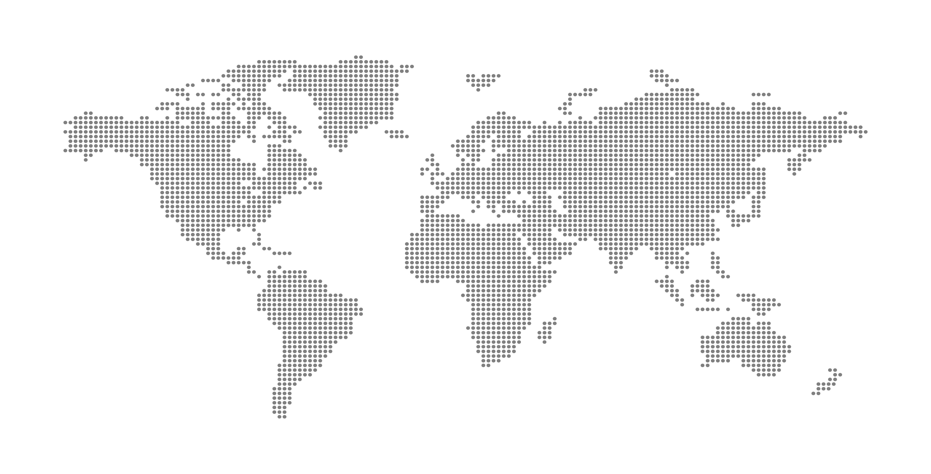
Microsoft global infrastructure (Buscar la de CRUE)
80+
Azure regions
500+
Datacenters
Notes:
It all starts at the infrastructure layer, and our approach to Azure, the world’s computer.
We offer the most comprehensive global infrastructure, with more than 80 datacenter regions—more than any other provider – operating across more than 500 datacenters globally.

Slide 23
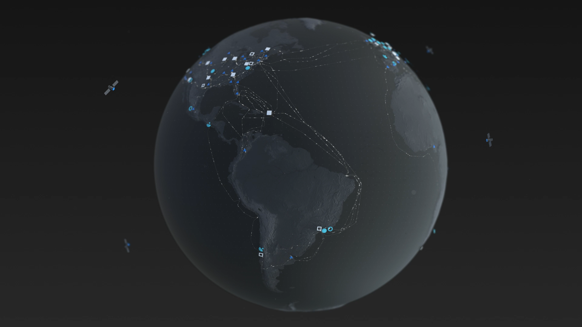

Fiabilidad
Region
Region coming soon
Network PoPs
Infraestructura global de Microsoft
80+ | 600K+ | 190+ | 100+ | 35 | 200+
regiones de todo el mundo | Kilómetros de fibra óptica y cable submarino | puntos de presencia (PoP) de la red | soluciones de cumplimiento normativo | países con residencia de datos | Parners de ExpressRoute
Azure global infrastructure | https://infrastructuremap.microsoft.com

Slide 24

Microsoft Sovereign Cloud da respuesta a todo el abanico de necesidades en materia de soberanía digital
Liderazgo en materia de regulación
Coordinación continua con los responsables políticos a nivel mundial
Restricciones de acceso para operadores
Soberanía en IA y procesamiento de datos
Residencia de datos
Se cumplen más de 100 normas de cumplimiento normativo
Recurso del Centro de confianza con más de 6 K políticas disponibles
Requisitos normativos
Continuidad de las actividades empresariales
Notes:
Microsoft Sovereign Cloud is built to support the full spectrum of those needs.
Regulatory requirements, customers can have confidence that data and operations meet local and national compliance standards.
Sovereign AI data processing, where customers can harness the power of AI while maintaining control over data, infrastructure, and model governance.
Operator access restrictions means customers retain authority, their data and workloads stay protected, with safeguards against unauthorized access, even from Microsoft.
Data residency means that information stays within defined geographic boundaries, meeting local laws and privacy expectations.
And finally, business continuity so that mission-critical operations can continue securely, even in the event of natural or geopolitical disasters.

Slide 25

Soberanía digital
La soberanía digital permite a las personas y a las instituciones participar en la economía digital de forma segura, independiente y con controles autodeterminados.
Sin embargo, los requisitos de implementación varían considerablemente según el país, el sector y la organización.
Controles operativos
Determinación por parte del cliente de los controles operativos y de cumplimiento
Datos y controles
Protección de la privacidad y prevención del acceso no autorizado a los datos
Notes:
Digital sovereignty can mean different things to different people. With needs that vary from organization to organization, or even between workloads, it’s not a one-size-fits-all concept. It’s achieved through choice, by activating the operational and data controls that aligns to your goals.

Slide 26

Determinación por parte del cliente de los controles operativos y de cumplimiento
Customer Lockbox
Controles operativos
Data Guardian
Controles de soberanía en el portal de Azure

Slide 27
Protecting privacy and unauthorized access to data
Azure Key Vault Premium
Azure Key Vault managed HSM
Controles de datos
External Key Management
Azure Confidential Computing
Sovereign Landing Zone
EU Data Boundary
Advanced Data Residency for Microsoft 365

Slide 28
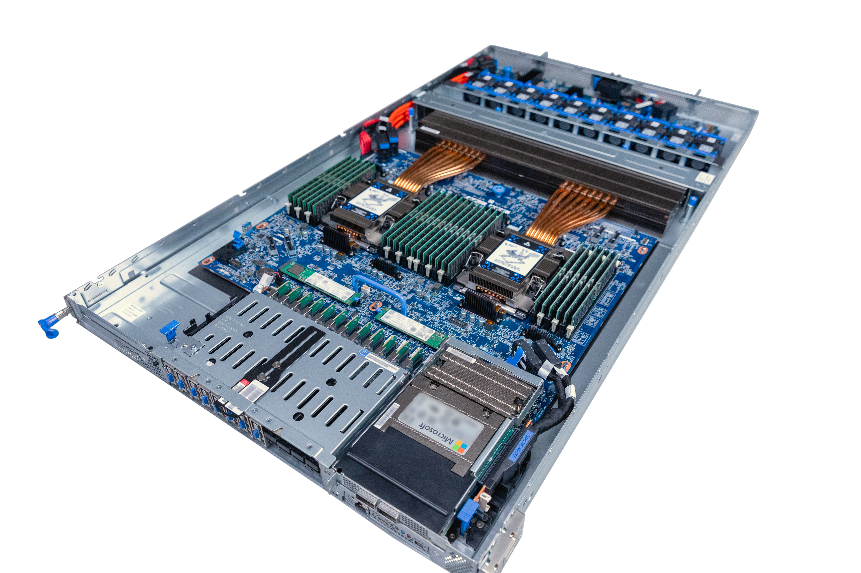
Controles soberanos en cada capa de la pila
Confidential Compute
Entorno de ejecución de confianza (TEE) basado en hardware
Integrated HSM
Un módulo de seguridad de hardware reforzado protege las claves
Caliptra
Circuitos integrados de código abierto para una informática fiable
Datacenter Secure
Control Module (DC-SCM)
Controlador de gestión segura y plataforma Root-of-Trust
Azure Boost
Aísla el plano de control y el plano de datos, y descarga la red y el almacenamiento
Notes:
And as we mentioned we believe digital sovereignty should be foundational to our cloud and services, we have sovereign controls at every layer of the hardware and software stack so that organizations can maintain control, visibility, and assurance over their data, workloads, and infrastructure.
Every layer shown here represents a control point designed to prevent unauthorized access, tampering, or external dependency from undermining an organization’s control of its digital estate.
Confidential Compute, built on hardware-based Trusted Execution Environments (TEEs). Data remains encrypted not only at rest and in transit, but also in use so even cloud operators can’t access it while it’s being processed. This is a cornerstone of sovereign data protection, especially in multi-tenant cloud environments.
Integrated HSMs, hardened hardware modules that protect cryptographic keys. By managing keys entirely within customer domains, this guarantees that only the data owner can control access. These modules are essential for meeting national encryption standards and compliance requirements.
Caliptra, an open-source silicon design developed for trustworthy computing. Caliptra provides transparency in the silicon root of trust; enabling verifiable, auditable security right from the chip level. This openness is vital for sovereignty, as it allows independent verification without reliance on opaque, proprietary firmware
Datacenter Secure Control Module (DC-SCM), serves as the management controller and platform root of trust. It ensures that every system boots securely and can be attested, meaning a government or enterprise can confirm the integrity of their infrastructure before deploying sensitive workloads.
Azure Boost isolates the control plane and data plane, separating management operations from customer data processing. It also offloads network and storage operations to dedicated hardware, improving performance while reinforcing security boundaries. This separation isolates administrative functions from customer workload.
Together, these layers create a vertically integrated trust chain — from silicon to software. This architecture gives nations and enterprises verifiable control over how data is protected, who can access it, and where it resides. It’s how we make sovereign cloud a reality — not just a policy promise, but a technical guarantee

Slide 29
EU Data Boundary
Cumplimiento de la normativa de la UE
Apoyo a los valores europeos
Información adicional sobre la residencia de los datos de
Mayor control de los datos
Mayor transparencia
Encuentra los recursos más recientes sobre los límites de datos de la UE en la EU Data Boundary Website

Slide 30
Marco de contratación

Slide 31


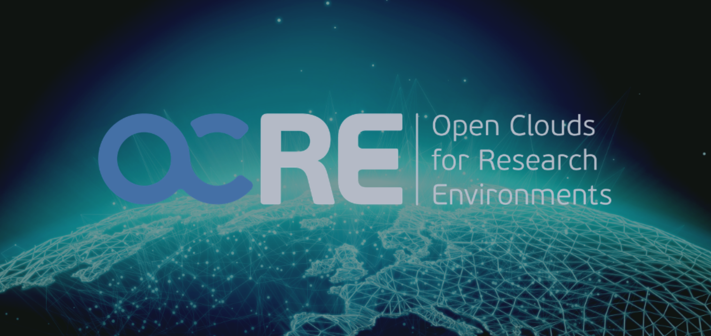
Mecanismos adicionales de contratación
Licencias de crédito de Azure
Contrato de campus
Acuerdo marco cloud

Slide 32
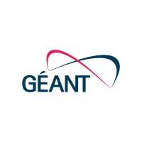
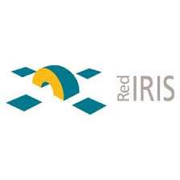
Acuerdo marco OCRE de GÉANT
Framework
Descuento
Egress traffic waiver
Procedimiento de
Contratación Pública
Business continuity
y recovery
Trabajo remote seguro AVD
Laboratorios virtuales
Ciberseguridad
Escalabilidad del LMS
Soporte de nuevas aplicaciones
AI y Big Data

Slide 33

Customer:
Universidad de Castilla-La Mancha
Industry:
Educación
Country:
Spain
Products and services:
Microsoft Azure Microsoft Azure Arc Microsoft Azure Automation Microsoft Update Management
Azure Monitor
Lee la historia completa aquí
La Universidad de Castilla-La Mancha migra sus servicios a Azure y deja de emitir el equivalente a recorrer 12 millones de km en coche gracias al acuerdo marco OCRE
“Creemos que la transformación digital de las universidades públicas debe ser global y sostenerse en los pilares de la creación de una cultura digital, el aprendizaje personalizado y la digitalización, sin descuidar el compromiso con la protección del medioambiente. El objetivo es dar respuesta a las demandas de la sociedad actual”
– Andrés Prado Domínguez, director del Área TIC en UCLM
Acuerdo marco
OCRE Estrategia cloud-first
Modernización IT
Migración de servicios a Azure
Adopción de Azure a escala
Contratación simplificada
Continuidad académica
Mayor resiliencia
Más agilidad operativa
Notes:
Situacion:
La UCLM ha formalizado la contratación de Azure a través del acuerdo marco OCRE, impulsado por la red europea GÉANT, para agilizar la adopción de la computación en la nube y allanar el camino a otras universidades públicas
Solucion:
El esfuerzo de la UCLM incluye la transposición de la ley europea de contratación a la nueva ley nacional de contratación del sector público y se ha materializado en la contratación de Azure a través del framework de OCRE con destino a los diversos campus de la UCLM. Es la primera acción de ámbito europeo de esta envergadura que se da en España para fomentar el cloud en el sector educativo.
Impacto:
La migración a Azure al inicio de la pandemia de los servicios relacionados con la gestión académica, la administración e investigación, permitió a la institución educativa continuar su actividad y dar una respuesta eficiente a los requerimientos del nuevo escenario.

Slide 35
Quiénes somos
Especialistas en el ámbito de la tecnología
Con casi 20 años de experiencia, somos expertos en la implantación de soluciones integrales de tecnología, con el objetivo de ofrecer soluciones únicas para entidades públicas y privadas

Slide 36
Presencia en España e internacional
Crecimiento continuo
Nuestra visión de negocio es ser la empresa española líder en tecnología, para ello, tenemos presencia con equipos certificados a lo largo del territorio nacional

Slide 37
Ámbitos de especialización
Unidades de Negocio y servicios
Ofrecemos un enfoque integral, siendo capaces de afrontar todas las vertientes de la digitalización de nuestros clientes.

Slide 38
Mercados Verticales
Productos, soluciones y servicios adaptadas al sector
Industria
Retail
Servicios y construcción
Laboratorios
Adm. Públicas
Telco
Transporte
Y logística
Banca y seguros
Alimentación
Químico y farma
Salud
Educación

Slide 39
+100 Partners Tecnológicos

Slide 40
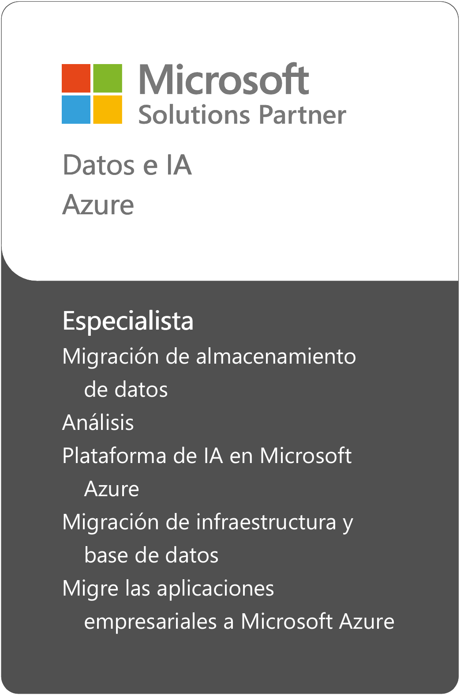
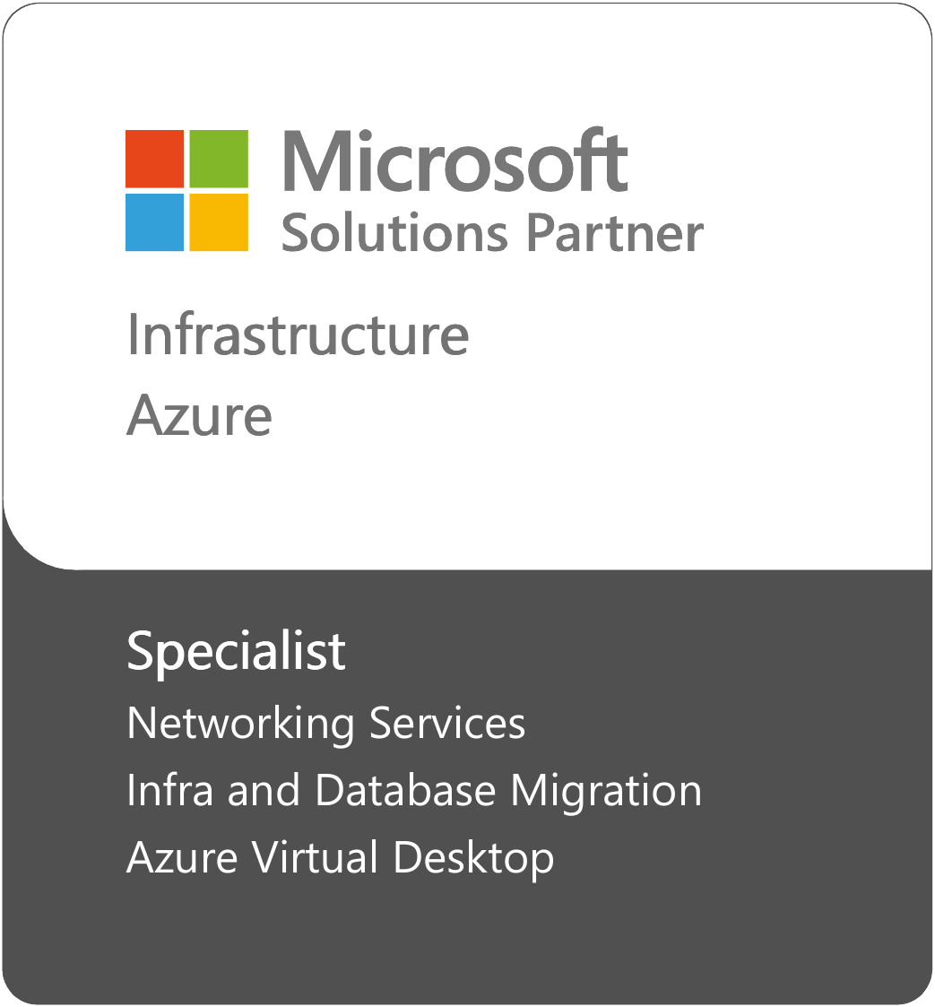
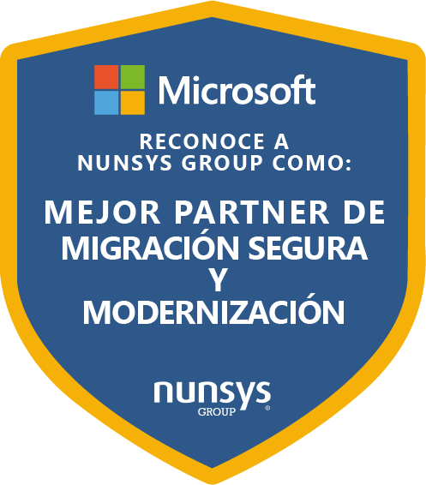
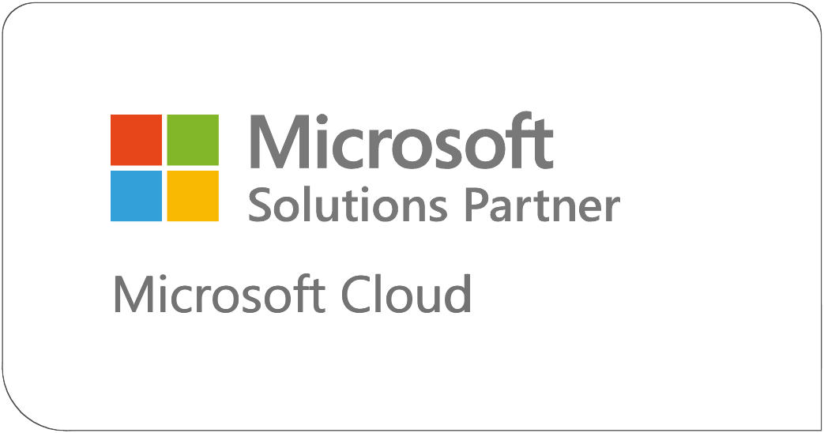
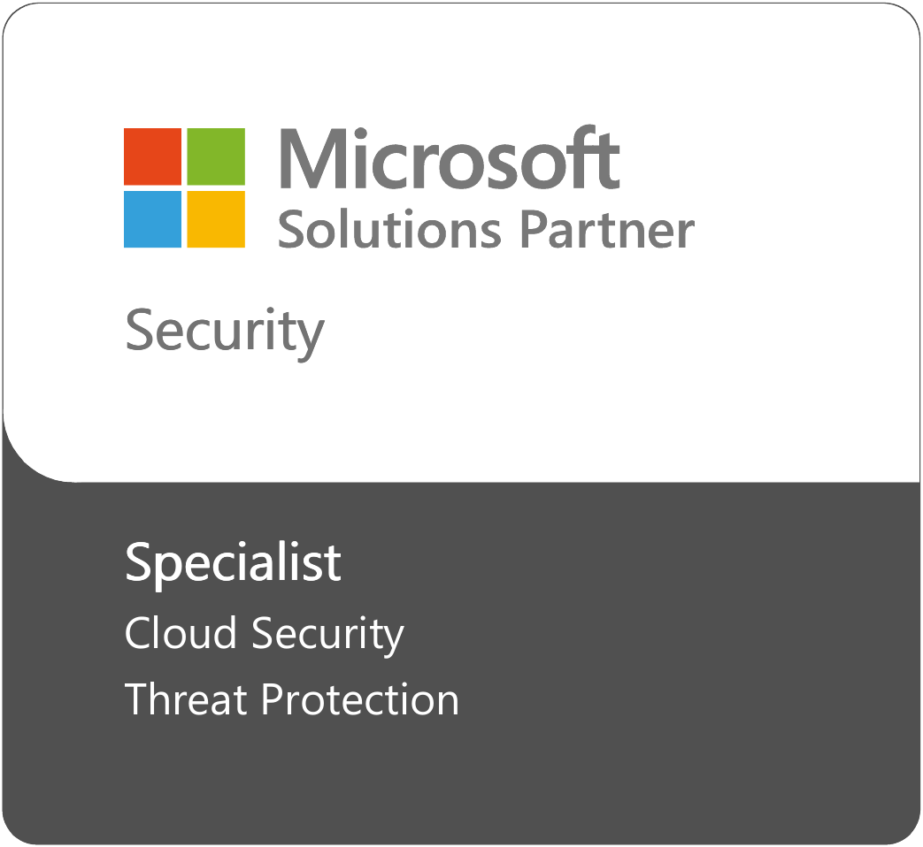
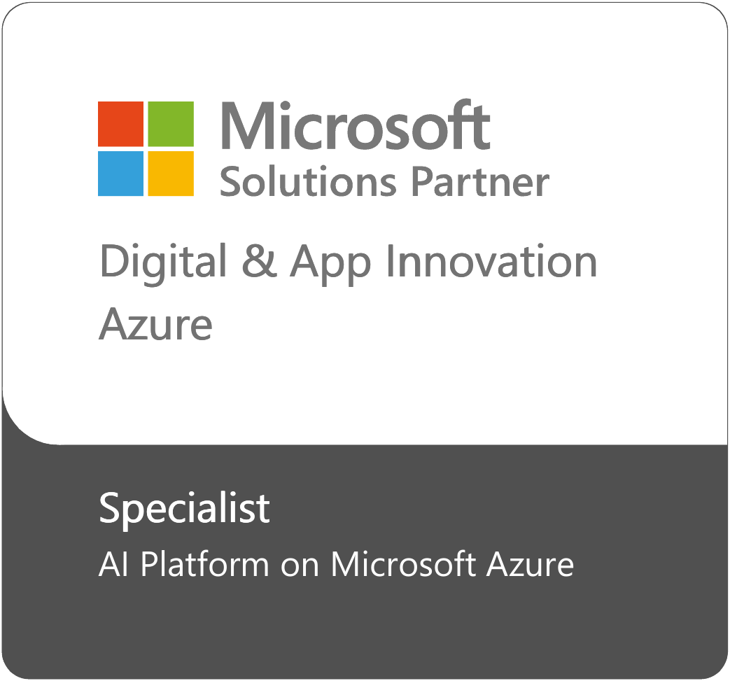
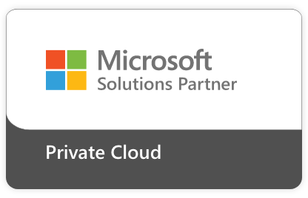
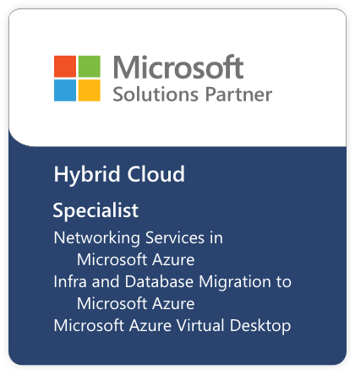
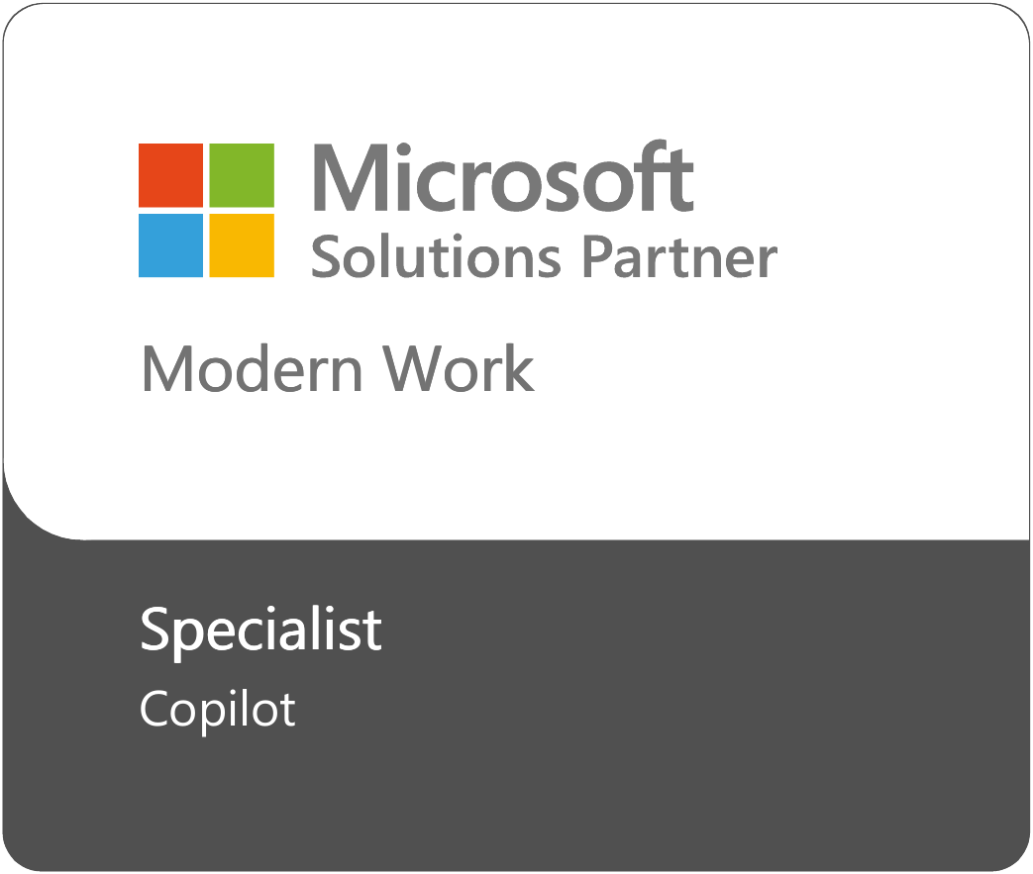
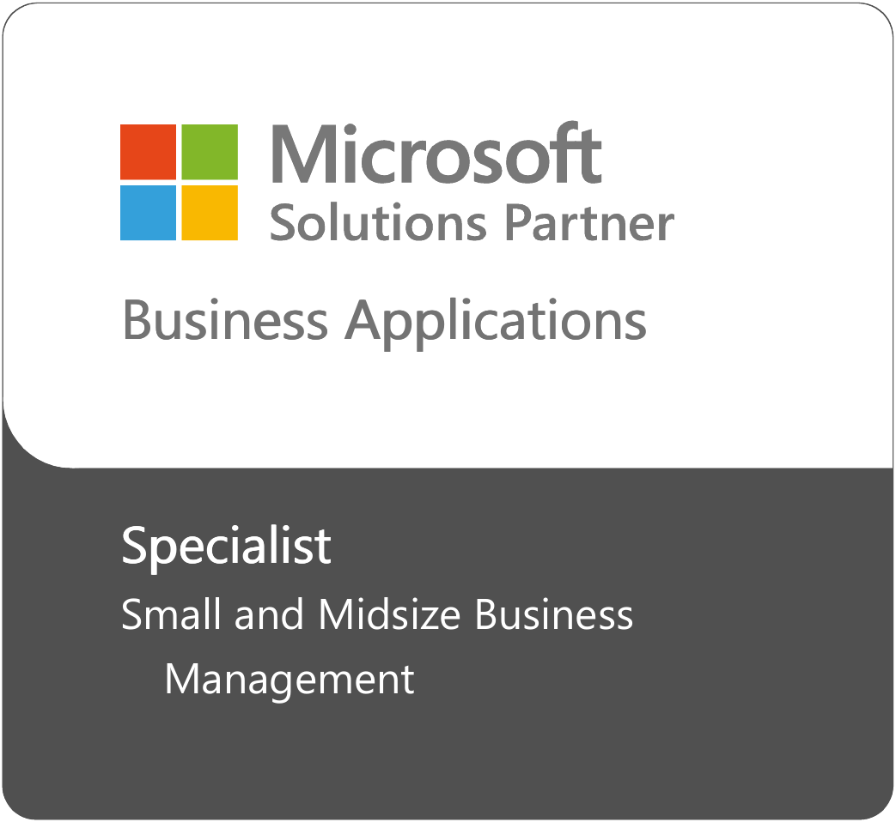
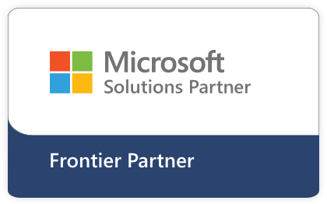
Alianza – Solutions Partner
Nunsys Group
Certificaciones y especializaciones
210
Certificaciones intermedias
48
Certificaciones avanzadas

Slide 41
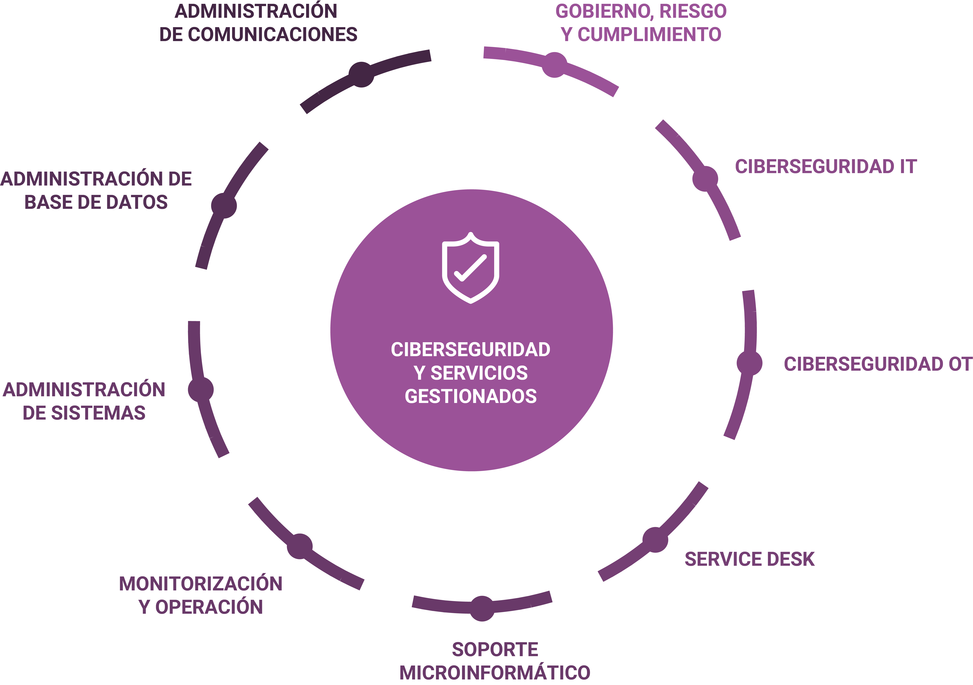
Ciberseguridad y Servicios Gestionados

Slide 42
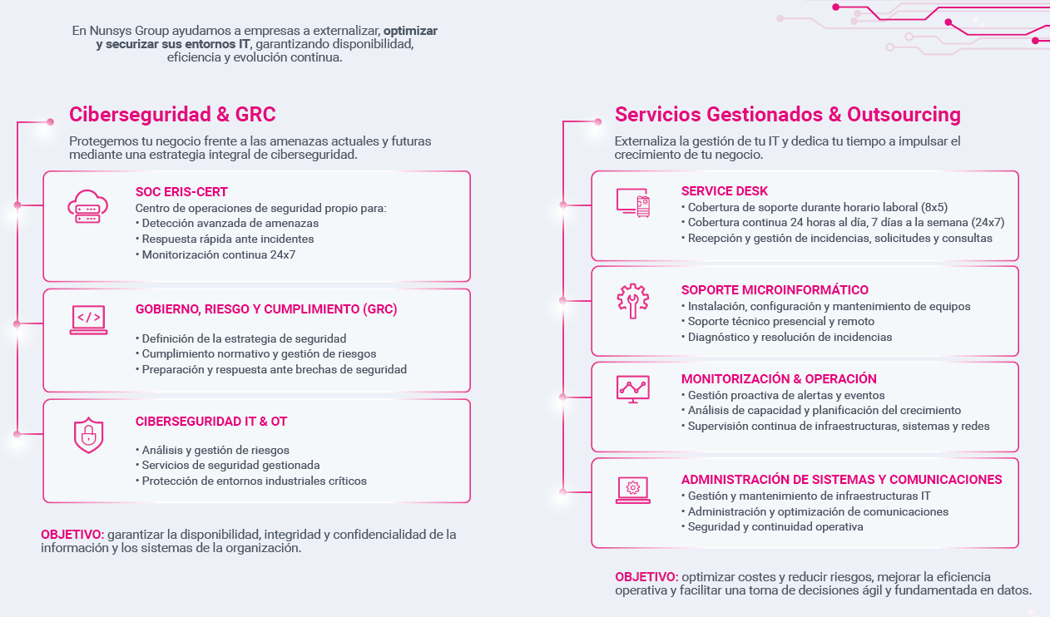

Slide 43
josep.sanchez@nunsys.com
rafael.perez@nunsys.com

