Slide 1



Community-Driven Excellence: Advancing Spanish and European R&E
Lise Fuhr
CEO Géant
Jornadas Técnicas de RedIRIS 2025, Toledo
21st May 2025
Notes:
Thanks for invitation, praise beauty of Toledo/venue, the city is famous for steel and marzapan – if that’s someththing you can work with
Honour to be invited by RedIRIS to give this keynote – RedIRIS founder member of DANTE, the predecessor to GÉANT, 32 years ago.
- Key theme is Community: everyone in this room is a part of it. “We coexist together and enforce each other.”
-

Slide 2
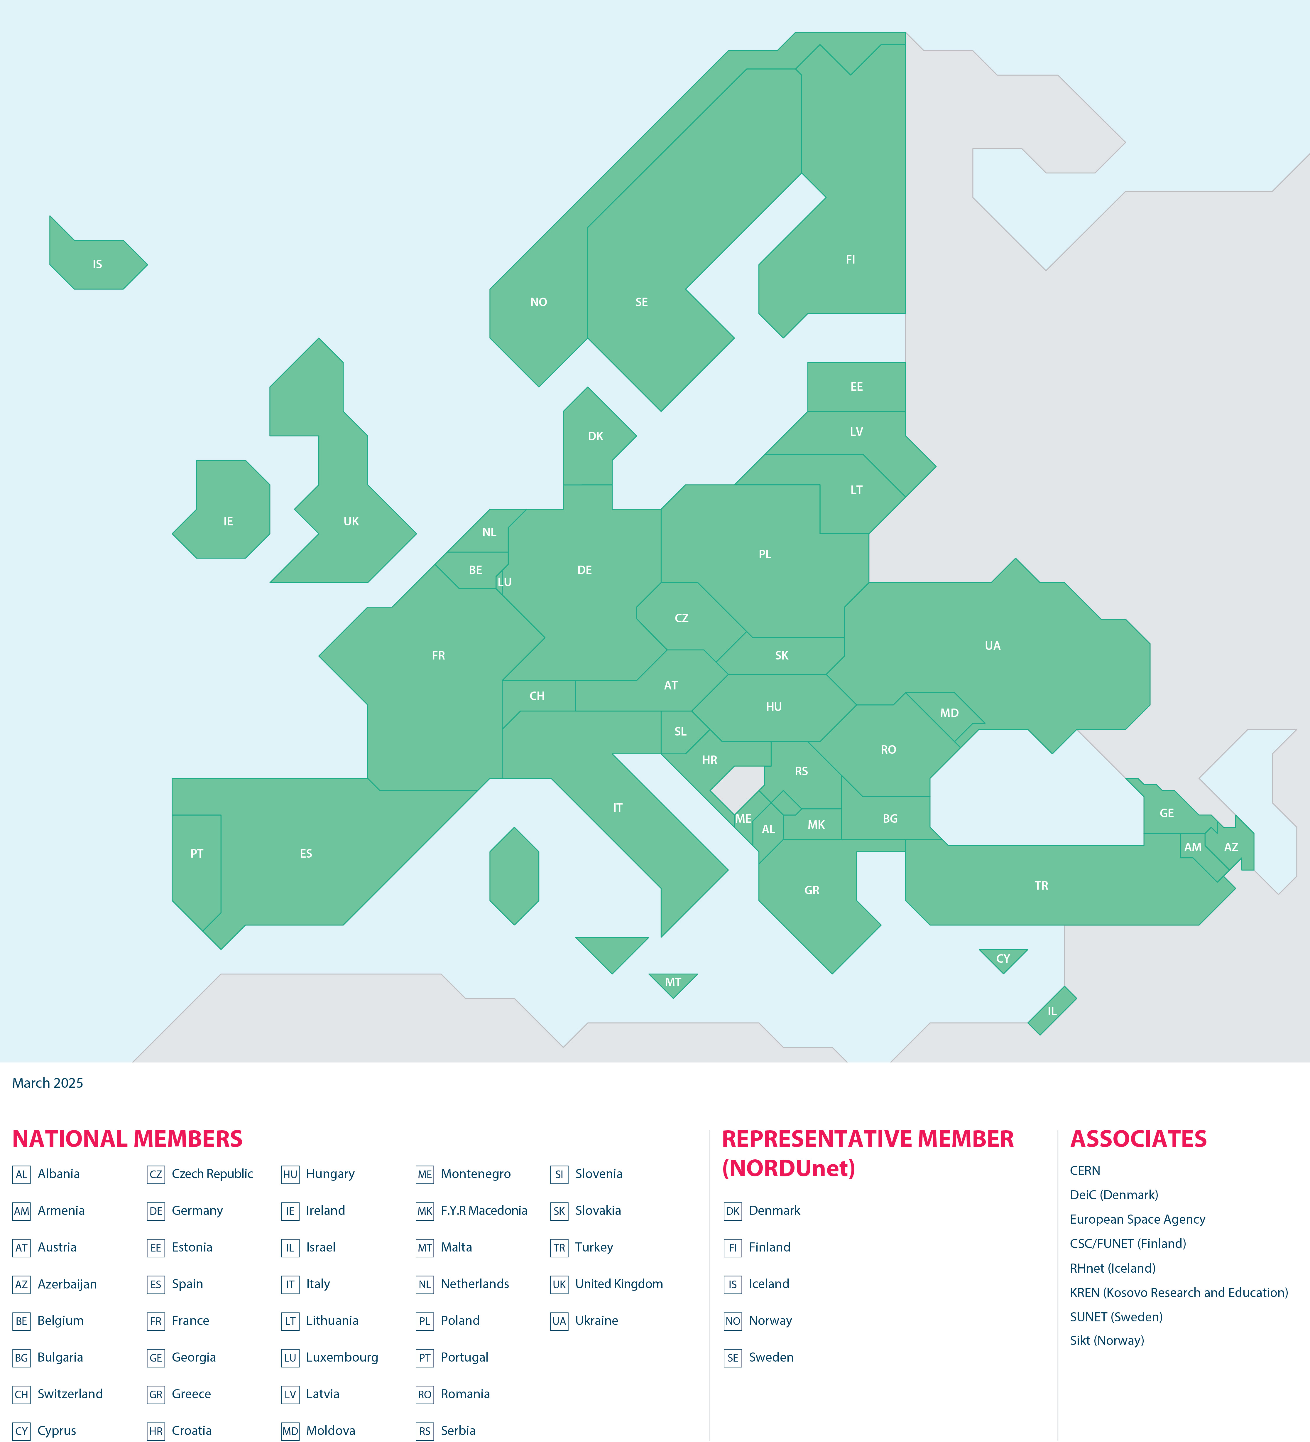

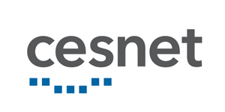































GÉANT: a European Membership Organisation
GÉANT represents all of Europe, bringing together 37 National Research and Education Networks (NRENs) plus NORDUnet (representing the Nordic countries)
Jointly we support 10,000 institutions and 50 million citizens across the continent.
GÉANT members connect universities, research institutions, laboratories, supercomputers, and more.
GÉANT is funded by the membership and the European Commission
Notes:
But first, what is GÉANT, and who are the members
(key points on the slide)

Slide 3

By uniting member needs and coordinating services, the GÉANT Association delivers cost-effectiveness unattainable by a single NREN. Its long-term partnership with the EC ensures dependable funding, supporting members’ financial stability and sustainability.
Connectivity costs reduced by consolidating national and global requirements in one network
  + access to a wide range of additional services
Framework agreements are delivering added value to members
  bargaining power, access to discounts, effort and time saved on procurement
A fair division of fees among all members ensures the costs are shared with a focus on bridging the digital divide
Seen by the EU as an indispensable partner
  opening up funding opportunities for NRENS, within GÉANT projects and more broadly
Economies of scale and financial sustainability
Notes:
EXTENDED TEXT
By consolidating national and global requirements in one network, connectivity costs for individual member institutions are significantly reduced, while at the same time their users receive the benefit of being able to access a wide range of services in addition to “simple connectivity”
A fair and transparent division of fees among all partners ensures the costs are shared with a focus on bridging the digital divide caused by geographic inequalities
Through framework agreements, GÉANT is delivering added value to its members in the form of effort and time saved on procurement and access to discounts negotiated by GÉANT
The GÉANT Association is seen by the EU as an indispensable partner for their vision, opening up funding opportunities for NRENS, both within GÉANT projects and more broadly

Slide 4
2015 2016 2017 2018 2019 2020 2021 2022 2023 2024 2025 2026 2027
GN4 FPA – H2020 ~8 Years
(~€225 Million)
GN5 FPA
(7 Years)
GN5-2
(2.5 Years €80 Million)
GN4-1
(1 Year €25 Million)
GN4-2
(2.5 Years €59 Million)
GN4-3
(4 Years €77.5 Million)
GN5-1
(2 Years €55 Million)
Shifting from a Pay-as-you-grow to an Infrastructure ownership model
GN4-3N
(5 Years €50.5 Million)
BELLA-S1
(5 Years €10 Million)
GN5-IC1
(3 Years €15 Million)
EuroHPC, Quantum, etc.
With 25+ years of experience in successfully accessing EU/EC funding instruments, GÉANT Association is uniquely positioned to address and respond to any potential changes in the funding landscape.
Notes:
Spanish institutions long standing participation in the GN Projects, currently from CSUC, i2CAT, and UPV/EHU, contributing to work on the Community Programme, network infrastructure technologies, network management automation, and of course leading the Task responsible for the Network eAcademy

Slide 5
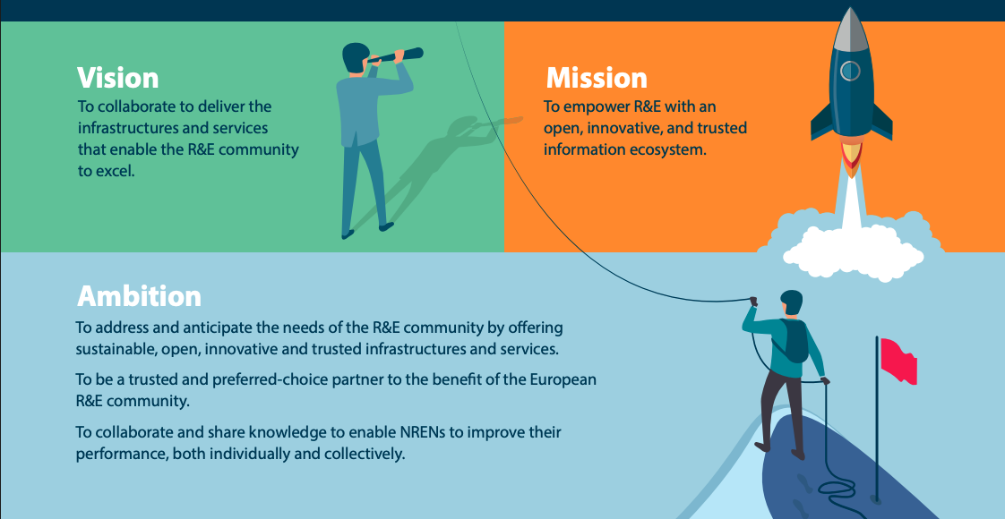
Community | Trust | Innovation| Passion
Notes:
Community is the very first of GÉANT’s core values
And serving the community underpins our vision and ambition too.

Slide 6
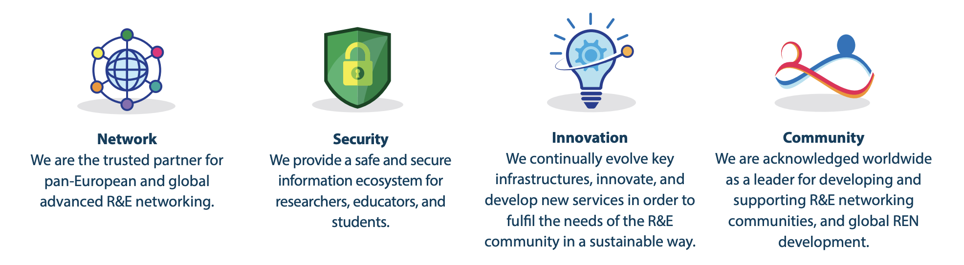
GÉANT’s Strategic Goals
Notes:
GÉANT has 8 strategic goals, and I will focus on 4 of them today.
Network, Security, Innovation And, at the core of it all, Community
The others are:
European Union (to be an indispensable partner)
Stakeholders (forge relationships for the benefit of the R&E community)
Governance (agile and of benefit to our membership)
Funding (to be sustainable)

Slide 7
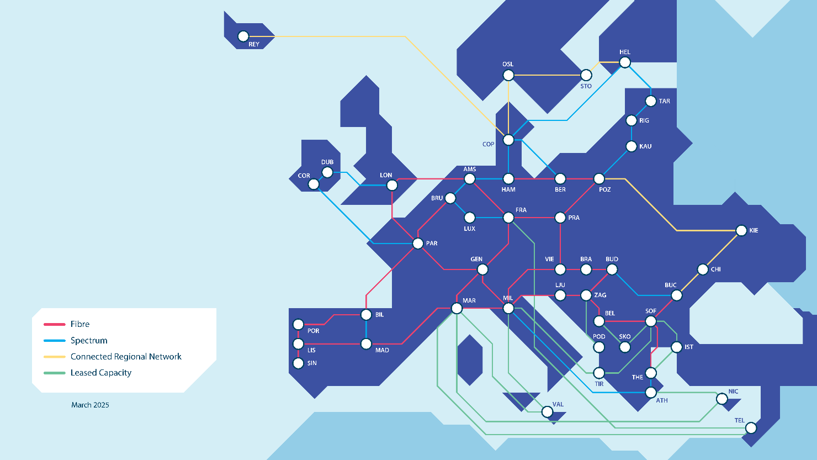
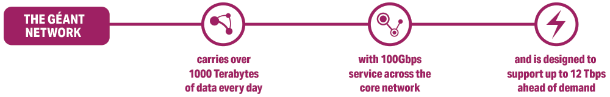
Tomorrow’s Network Today
GÉANT’s foundation is ultra-high-speed and secure connectivity: a recently refreshed terabit-ready pan-European internet purely for research and education, connecting 42 European countries via our NREN members.
Together we proudly support all science, all innovation, and all thematic areas – including high energy physics, biological research, earth observation, and so much more.
We are essential to Europe’s current strength and its future, supporting such entities as CERN, ITER, Copernicus, and all of Europe’s Research Infrastructures.
Notes:
Both RedIRIS’s AP1 and AP2 Connections to the GÉANT backbone are at 400Gbps – connecting to the heart of Europe

Slide 8



GÉANT backbone network upgrade, GN4-3N project
From 14 countries with short-term fibre contracts to 25 countries with long term fibre or spectrum contracts
276
From 11.200 km to 30.900 km of fibre/spectrum routes
43
    From 6.26 M€/year to 3.53 M€/year in annual maintenance cost for fibre and equipment
%
%
Strong foundation of long-term infrastructure
  Bridging the digital divide by expanding the network
  Reducing dependency on the market
Notes:
All of this is being delivered thanks to the success of the recently completed GN4-3N project

Slide 9
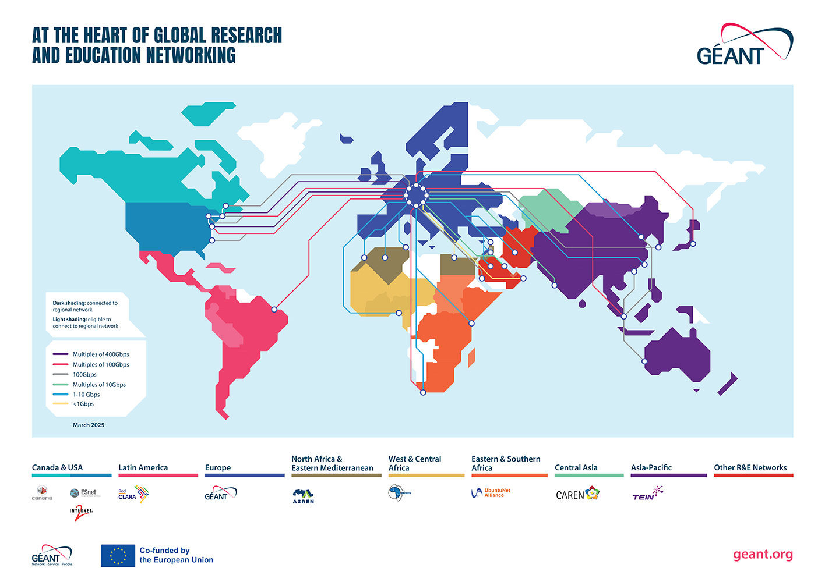
At the Heart of Global Research and Education Networking
Notes:
Of course connectivity doesn’t stop at the borders of Europe.
The GÉANT network interconnects research, education and innovation communities worldwide, with secure, high-capacity networks.
The BELLA project was of particular importance, connecting Europe with Latin America via RedCLARA
(We design, plan, build and operate the large-scale, high-performance GÉANT network that connects European NRENs to each other and the rest of the world for sharing, accessing and processing the high data volumes generated by research and education communities and for testing innovative technologies and concepts.)

Slide 10

The GÉANT network is the most advanced and well-connected research and education network in the world, enabling secure collaboration and partnership, even for the most demanding scientific applications.
Engineered to meet the specific needs of the R&E Community
  a maximum of 60% utilization before the infrastructure is being upgraded free of charge (commercial ISPs have utilization of 95%)
  optimised for R&E traffic which occurs in peaks rather than a constant flow of traffic
Reliable, robust, and with unprecedented capillarity
  99.99% monthly access availability
  over 4,000 terabytes of data transferred every day via the GÉANT IP backbone
  connecting over 50 million users at more than 10,000 institutions across Europe and reaching over 100 national networks worldwide
High-Performance connectivity, engineered for R&E
Notes:
Engineered to meet the specific needs of the R&E Community
The Network is engineered to for a maximum of 60% utilization before the infrastructure is being upgraded free of charge (In comparison commercial ISPs have utilization of 95%). This way the network is optimised for R&E Traffic which occurs in peaks rather than a constant flow of traffic.
GÉANT network is reliable, with 99.99% monthly access availability, and robust, with over 4,000 terabytes of data transferred every day via the GÉANT IP backbone, with unprecedented capillarity - connecting over 50 million users at more than 10,000 institutions across Europe and reaching over 100 national networks worldwide
GÉANT has been building R&E networks globally for over 20 years, ensuring Europe’s digital leadership and global competitiveness in an interconnected world by seizing the full potential of the continent’s ongoing digital transformation

Slide 11
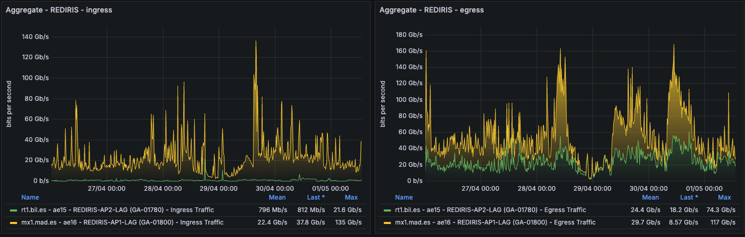
Traffic keeps flowing – Even in a crisis
Notes:
I am pleased to note that even during the unprecidented, and I can only imagine, frightening, power outages here in Spain at the end of last month, RedIRIS’ connection to the GÉANT backbone stayed up.
As you can see from our network statistics, traffic stayed flowing throughout.
This is a reminder though, of the importance of resilience in the network, of multiple routes out of the Iberian peninsula, and the challenges we all face to adapt to a changing climate.

Slide 12
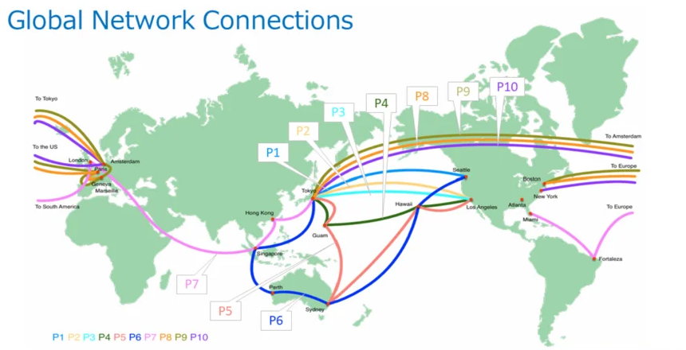

SC24 Demo: A world-scale multi-path data transfer experiment
The ambitious experiment, held at SC24 and coordinated by NICT (National Institute of Information and Communications Technology), NII (National Institute of Informatics) and GÉANT, used the MMCFTP (Massively Multi-Connections file transfer protocol), developed by NII to transfer data between Japan and the US over ten different 100Gbps lines, simultaneously.
“We constructed a world-scale 800 Gbps experimental network. This would not have been possible without the cooperation of many organisations.”
Hidehisa Nagano Director General at ICT R&D Center of NICT
Notes:
The main aim was to prove the feasibility of high-speed multi-path transfers and promote the use of global data transfer in cutting-edge science and technology.

Slide 13
GÉANT’s Strategic Goals

Slide 14
From trusted identity management to cloud access and cybersecurity, GÉANT’s services empower R&E institutions to operate efficiently, innovate, and work jointly on a global scale.
DDoS, Trusted Certificates, Firewall on Demand, RTBH etc.
Training and Awareness
Research Activities
Security Baseline and Benchmarking
Advanced, tailored, and secure services
Notes:
GÉANT supports safe and secure connectivity through a portfolio of security services
In addition to this a peer network of CSIRT teams is embedded in each NREN and coordinated through the TF-CSIRT community, with access to over 500 CSIRT teams across Europe.
GÉANT works globally on these security mechanisms to ensure that its national and cross-border elements are as secure as possible

Slide 15
GÉANT Security
Helping protect and secure vital research and education resources
  DDos Protection - A combination of detection and mitigation tools protects the connection of an NREN from unwanted excessive traffic coming through the GÉANT network
  Trusted Certificate Services - The Trusted Certificate Service gives NRENs and their constituents easy access to high quality certificates of the most used types: SSL, grid, client, code signing and document signing.
  Firewall on Demand - A BGP-FlowSpec-based (RFC5575, RFC7674) DDoS mitigation solution which was previously developed in earlier phases of the GÉANT project and is currently provided in the GÉANT core network
security.geant.org

Slide 16
GÉANT Security
Helping protect and secure vital research and education resources​
Training and awareness:
  CLAW - The annual CLAW event supplies training and exercises for participants from NRENs for both communication teams as for technical (ICT, Security) teams as well as management.
  Training - A range of security training services available, both classroom based and online.
    Transits I and II: flagship classroom training for incident response team
    Operational network security: Online training, 4 modules of 4 to 5 1-hour webinars
    Forensics Online training 2 modules of webinars
    Blue team training: A small scale online hands-on training for incident response teams focused on analysis and forensics.
  Cybersecurity month - Security awareness made easy with a library of materials and a full annual campaign every October.
security.geant.org

Slide 17
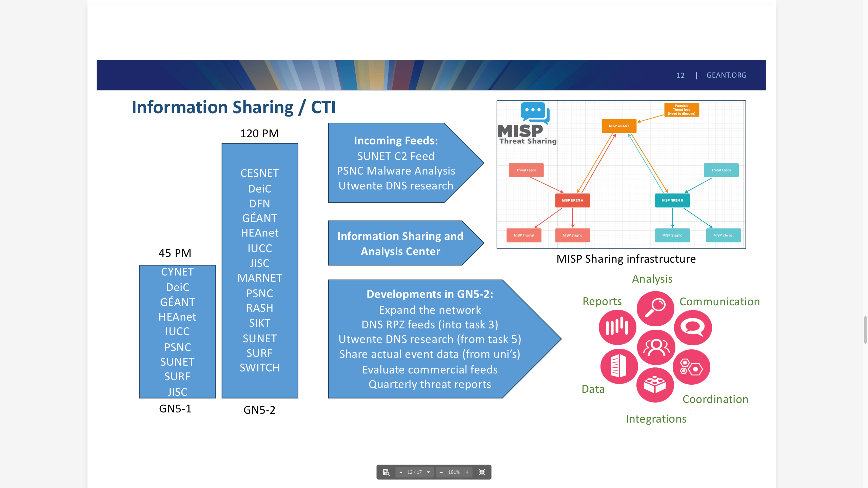
Developing a Security Intelligence Hub for NRENs
The primary goal of the Security Intelligence Hub is to enable threat intelligence sharing, reduce duplication of effort, and provide verified, actionable data.
This platform will facilitate the sharing of actionable threat data, such as Indicators of Compromise (IOCs), enabling NRENs to collaborate more effectively and strengthen collective defences against threats such as ransomware, phishing, crypto mining and more.
Creating a central point of contact for cybersecurity within the R&E community
GÉANT and the NRENs will build and maintain a joint, hybrid security Intelligence team
Notes:
One of our key initiatives, that I am keen to highlight is the development of Security Intelligence Hub for NRENs, building on the knowledge sharing already happening within the community.
(Multiplier effect – build on the work done on a national level, to expand it to the European, and then global level via our partners.)

Slide 18

CyberSecurity monthly newsletter
Sharing the latest news, threats and solutions focused on the research and education sector.
Over 350 subscribers in the first two months.
Full archive and subscription link at: security.geant.org/security-newsletter/
​

Slide 19

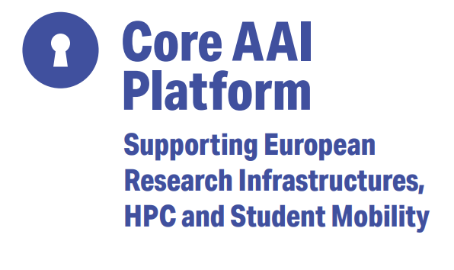

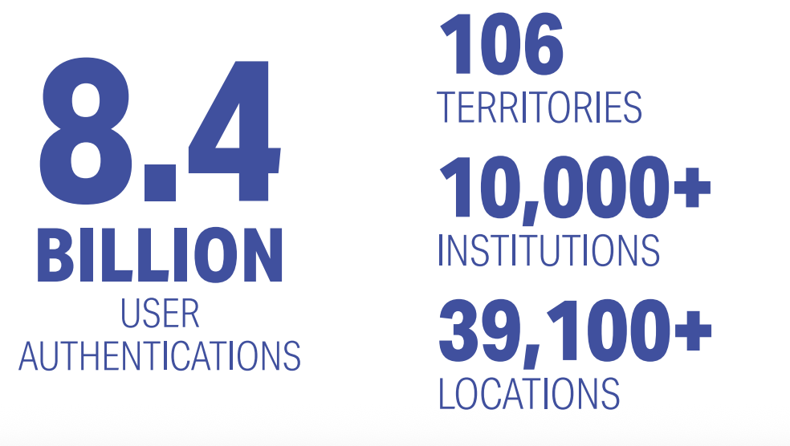
From trusted identity management to cloud access and cybersecurity, GÉANT’s services empower R&E institutions to operate efficiently, innovate, and work jointly on a global scale.
Advanced, tailored, and secure services
Notes:
GÉANT’s trust and identity services enable trusted, seamless, integrated access to resources and services for research and education, across institutions and borders.
From federated identity with eduGAIN to secure Wi-Fi with eduroam, from access to high performance computing to the first EOSC node, T&I services enable collaboration, protect user privacy, and support efficient operations for students and researchers worldwide.

Slide 20

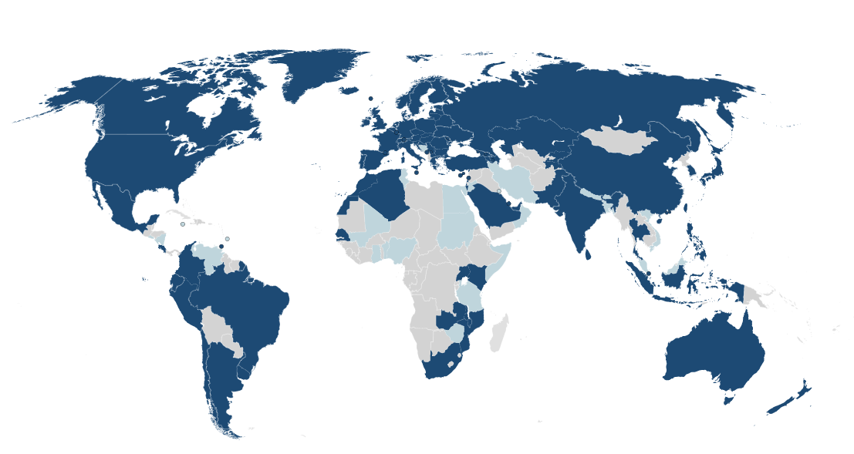
eduroam
Linking students to the global community
eduroam provides a secure global roaming infrastructure for the research and education; users authenticate locally and get online in eduroam-enabled locations
A global network of users across 106 territories.
More than 8.4 billion national and international authentications in 2024.
A worldwide success story
From its early beginnings as a joint venture between a few European universities to today – with millions of users in more than 100 territories worldwide, eduroam has been an amazing success story and an example of research and education collaboration.
eduroam.org @eduroam​

Slide 21

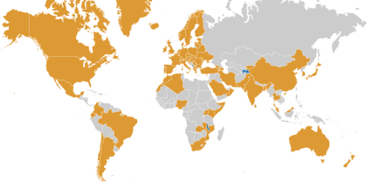
eduGAIN
Enabling secure Single Sign On services to global research and educational resources
Federated identities enable users to access a wide range of services using their account managed by their 'home’ institution.
Improves access.
Improves security.
Reduces management overhead and costs.
January 2024:
79 Federations active
9,109 Entities
5,525 Identity Providers
3,604 Service Providers
edugain.org

Slide 22


Securing Students Identities
GÉANT’s MyAcademicID service
Built on the Core AAI platform
Supporting the CEF
Funded through the European Student Card Initiative.
The development of MyAcademicID is continued in the EU Digital Identity Wallets.
GÉANT is involved in the large-scale pilot DC4EU under the Digital Europe Programme, testing use cases for education and social security.
Notes:
It enables students to authenticate for their studies abroad using their home student account, meaning students can easily connect their personal and academic identities, thanks to the bridge with eIDAS national nodes, and enable the once-only principle by introducing the European Student Identifier – in turn supporting the Erasmus+ programme.

Slide 23
GÉANT’s Strategic Goals

Slide 24

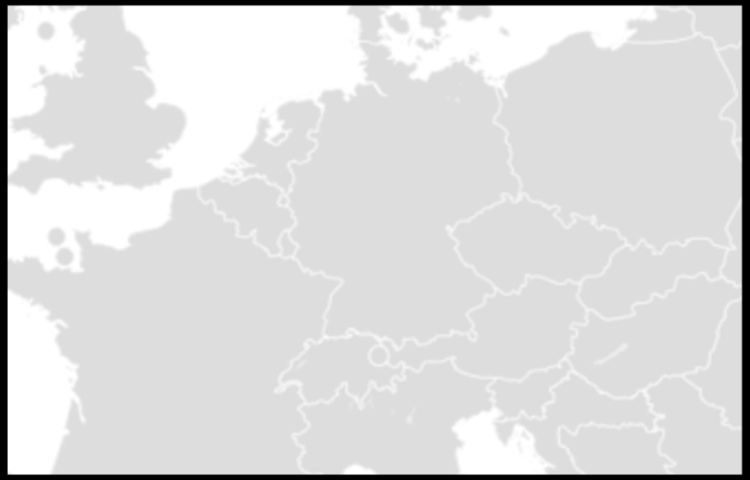



Time and Frequency network
Starting with the GN5-2 project, GÉANT and NRENS will be working with national meteorology institutes (NMIs) to develop a pan-European fibre based network to support the interconnection of optical clocks, building on GÉANT’s expertise in providing cross-border connectivity for NRENs.
This network will support the redefinition of the SI second, enable fundamental physics research and ultimately improve the resilience of critical infrastructures across Europe, by providing a higher-accuracy alternative to satellite-
based time and frequency distribution.
Lithuania
UMK
Torun
PTB
Braunschweig
PSNC
Poznan
UvA
Slubice
NPL
London
VSL
Delft
GUM
Warsaw
Lille
OB
Brussels
Wroclav
Prague
IRE
ILNAS
Luxembourg
CESNET
Hradec
Kralove
Cieszyn
Karlsruhe
Ostrava
OP
Paris
ISI
Brno
Strasbourg
Munich MPI
Proof-of-concept link between Poznan and Braunschweig was completed on 23 Sep 2024, proving both frequency and time transfer
The ring supports 4 NMIs that are working on the redefinition of the SI second
Basel
BEV
Vienna
METAS
Bern
Innsbruck
CERN
Geneva
Ljubljana
Grenoble
Trieste
Zagreb
Modane
INRIM
Turin
Milan
GÉANT and NRENS working with NMIs
Notes:
Starting with the GN5-2 project, GÉANT and NRENS will be working with national meteorology institutes (NMIs) to develop a pan-European fibre based network to support the interconnection of optical clocks, building on GÉANT’s expertise in providing cross-border connectivity for NRENs.
This network will support the redefinition of the SI second, enable fundamental physics research and ultimately improve the resilience of critical infrastructures across Europe, by providing a higher-accuracy alternative to satellite-based time and frequency distribution.
The work is supported by the newly established Special Interest Group on Time and Frequency, providing a forum for the community working on Time & Frequency

Slide 25
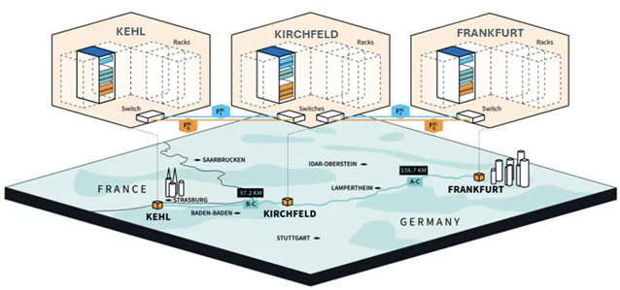
Quantum Key Distribution (QKD) in-the-field demonstrator
The experiment was conducted in Germany, with access to the network infrastructure provided by GÉANT.
Communication was established over a link spanning 253.9 km between Frankfurt and Kehl with a 56.0 dB loss and a relay in Kirchfeld, approximately three-fifths of the way. Employing the Twin Field Quantum Key Distribution protocol, a key distribution rate of 110 bit/s over 254 km was achieved.
Quantum Communication at a national scale
The first the first major in-the-field demonstration of coherent quantum communications using telecoms standard equipment and infrastructure
GÉANT, Toshiba Europe limited, PSNC and the Anglia Ruskin University collaboration
Notes:
The year 2025 holds a special significance for the global research community as it is celebrated as the UNESCO International Year of Quantum Science and Technology. This commemoration marks the centenary of the development of quantum mechanics, something that has profoundly influenced our understanding of the universe and the very fabric of reality.
Last year GÉANT, Toshiba, the NREN PSNC, and the Anglia Ruskin University came together to work on the first major in-the-field demonstration of practical quantum communications using telecoms standard equipment and infrastructure. The key benefits of these techniques are the ability to be able to detect if communications have been intercepted or modified en-route, which makes these techniques ideal for highly sensitive data interchange.
Then just 2 months ago GÉANT launched the Special Interest Group on Quantum which aims to provide an open forum for the diverse community engaged in quantum technologies, including quantum networking, computing, sensing, cryptography, and communication.

Slide 26
Community-driven innovation means developing solutions that address the specific challenges of member NRENs and their user communities, delivering measurable value, a positive societal impact, and driving digital excellence.
Innovation Programme
Participation in EU funded projects & collaborations
GÉANT incubators
Testing and piloting of new technologies
Value driven innovation for digital excellence
Notes:
As part of the GÉANT Community Programme, the GÉANT Association supports an Innovation Programme for research projects carried out by the GÉANT community to enable initial development, establish a proof of concept or testing of new ideas, with lightweight administrative constraints
GÉANT Members participate in EU-funded projects and collaborative R&D initiatives, that push the boundaries in areas like cable sensing, quantum communication, time and frequency networks
GÉANT incubators provide space for working on innovative but potentially disruptive technologies, business models and trust models
Through joint innovation efforts members are able to test and pilot new technologies, and deliver cutting-edge services tailored for research and education institutions enabling them to achieve digital excellence on a global scale

Slide 27
Spanish Contributions to the Innovation Programme
2024: Design User Experiences for Digital Identities (University of Malaga)
The number of digital identities that users need to manage are increasing due to the diversification of actors offering digital services and identity provision. The main objective of this project is to explore the user experience during the users’ decision processes about the digital identities they choose for accessing digital services in the contexts of research and education. This will contribute to solving frequent mismatch adoption problems between technical solutions and user experiences with digital identities, both federated and decentralised. The aim is to develop solutions that are truly inclusive and address the unique challenges faced by these individuals.
2022: SIEVA: SIEM Visibility Assessment (i2CAT)
Value driven innovation for digital excellence
Notes:
Projects within the 2024 Innovation Programme were awarded EUR 50,000 each.
I would like to celebrate the team from the University of Malaga on their Trust and Identity focused, successful submission to the 2024 Innovation Programme.
The next editions, the 2026 Innvoation Programme will launch this coming Autumn – so start thinking about your proposals, and keep an eye out for information on how to make a submission in the coming months.

Slide 28
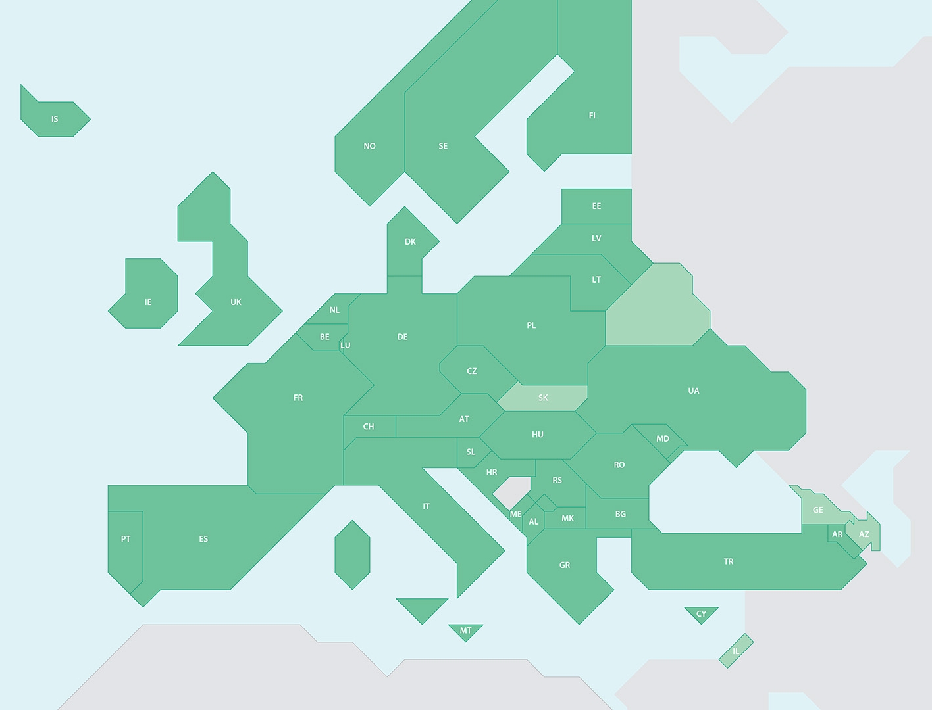
OCRE Frameworks – Open Cloud for Research Environments
Cost reductions unachievable to any single institution: cost savings of up
to 30%, after moving to the framework contracts.
30
Previous iterations provided Cloud services to 101 Spanish institutions.
€12.8m total Spanish consumption
Previous OCRE = 4 Cloud Providers
OCRE 2024 = 10 Cloud Providers
Previous OCRE = 7 Spanish Suppliers
OCRE 2024 = 12 Spanish Suppliers
%
∼ 1000 Call off Contracts = time and effort of 1000 procurement processes saved
Strong foundation of long-term infrastructure
OCRE 2024 framework includes 39 members.
Notes:
A different sort of innovation is the Open Cloud for Research Environments, which I hope needs no introductions here as the previous iterations provided Cloud services to 101 Spanish institutions.
The OCRE 2024 Framework has been available since February 2025 and will run until 2030 across 39 countries in Europe.
The framework’s catalogue includes 416 cloud offerings from Hyperscalers and European Original Infrastructure Providers (OIPs).
The OCRE Frameworks provide easy, cost-effective access to commercial cloud and digital services tailored for research and education institutions. With pre-negotiated agreements and ready-to-use solutions, OCRE helps institutions accelerate digital transformation, optimize research workflows, and control costs, all within a secure and compliant framework.

Slide 29
GÉANT’s Strategic Goals

Slide 30

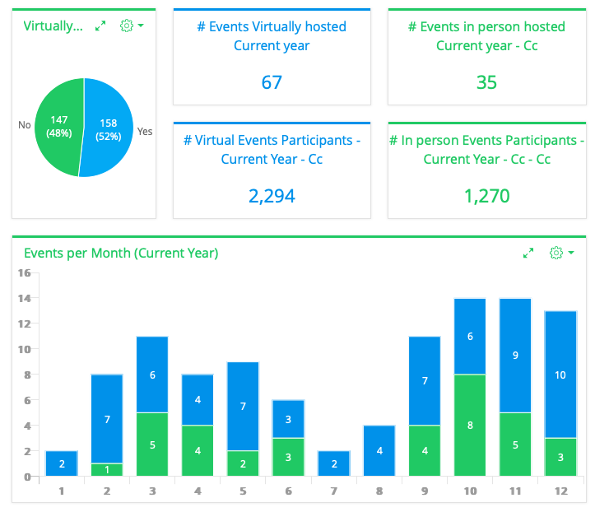
Enabling collaboration and knowledge transfer
GÉANT Association provides a trusted platform where communities can connect, where collaboration is facilitated, and information and knowledge can be shared.
It enables NRENs to act and work not in competition, but in alignment with each other.
100+ events, workshops, trainings, infoshares
yearly
14 active Special Interest Groups and Task Forces
+
Coordination and Working Groups on topics such as EOSC, HPC, Quantum Communications, etc.
Notes:
GÉANT Association provides a trusted platform where communities can connect, where collaboration is facilitated, and information and knowledge can be shared.
It enables NRENs to act and work not in competition, but in alignment with each other.

Slide 31
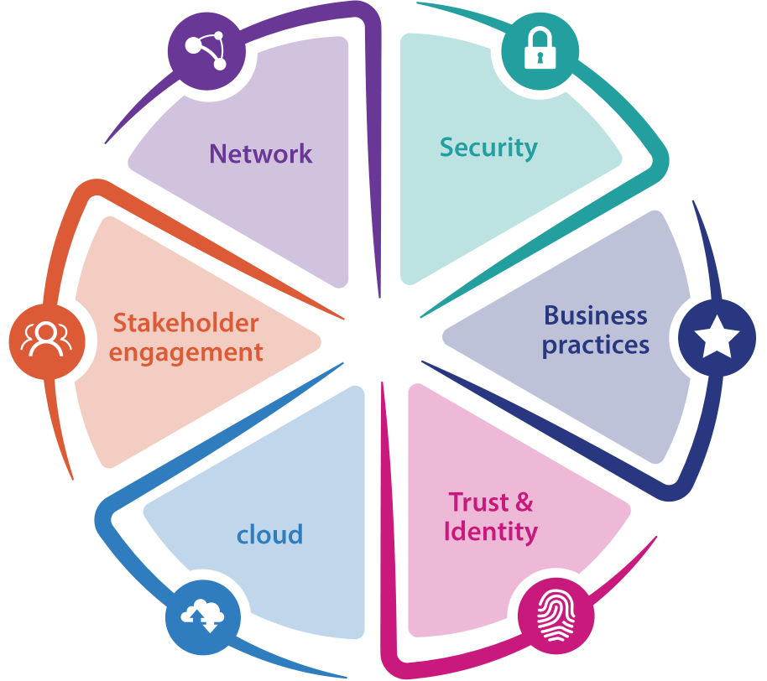
Community Programme: SIGs & TFs
Enable collaboration across the commun​ity for the development of the next generation of networking technologies and services.​
Explore emerging issues in research and education networking, develop strategies and solutions to address them.
Produce and test fresh and innovative ideas applied through specific research activities and initia​tives.
Welcome grass roots and world experts.
community.geant.org
Notes:
Much of this collaboration is carried out via the Communitiy Programme
Enable collaboration across the commun​ity for the development of the next generation of networking technologies and services.​
Explore emerging issues in research and education networking, develop strategies and solutions to address them.
Produce and test fresh and innovative ideas applied through specific research activities and initia​tives.
Welcome grass roots and world experts.

Slide 32
SIG on Artificial Intelligence
Upcoming meeting
Initial Focus:
1. Knowledge Sharing:
Introduction to potential applications of AI
Comprehensive knowledge hub
EC regulation monitoring
2. Use Case Development:
Identify specific use cases within the NREN project
Develop concepts for pilot projects
3rd SIG-AI meeting 9th June 2025
KEY QUESTIONS:
How can AI enhance cybersecurity, above-the-net services, network management, and network services currently offered by GÉANT and the NRENs?
How do the new EC regulations on AI affect GÉANT and the NRENs?
Notes:
An example of one of our newest Special Interest Groups is SIG-AI, started in 2024
How can AI enhance cybersecurity, above-the-net services, network management, and network services currently offered by GÉANT and the NRENs?
How do the new EC regulations on AI affect GÉANT and the NRENs?
. Knowledge Sharing:
workshops and presentations to introduce NREN to potential applications of AI in networking
Compile comprehensive knowledge base in utilizing AI within NREN environments
Serve as a cumulative starting point and knowledge hub
Look at how GÉANT and the NRENs will be affected by EC regulations concerning AI
2. Use Case Development:
Identify specific use cases within the NREN project areas (cybersecurity, above-the-net services, network management, and network services) where AI can be demonstrably beneficial
Develop concepts for pilot projects with clear objectives and measurable outcomes to validate the chosen applications

Slide 33




Learning Opportunities for the GÉANT Community
Community includes NRENs, researchers, Higher Education and users with federated access
GÉANT.tv
eAcademy
Future Talent
Mentoring
Click links for more information or visit learning.geant.org
Notes:
On a very practical level as members of the GÉANT Community, resources are available to you all….

Slide 34
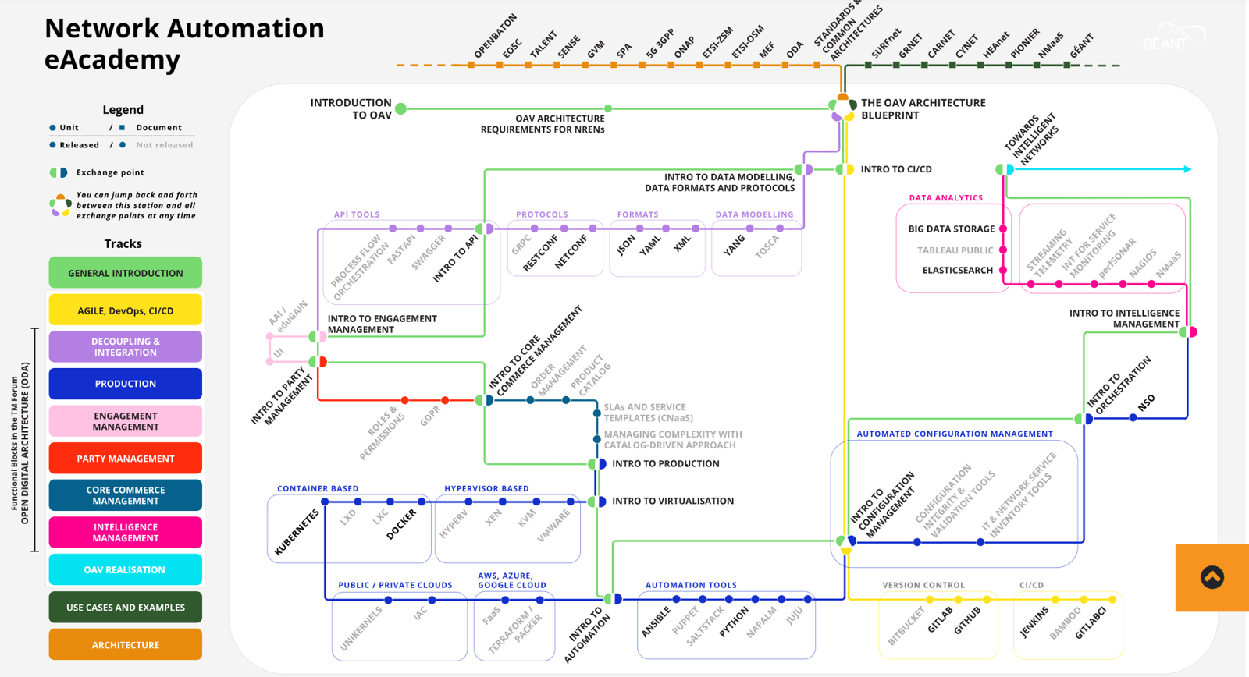
eLearning Opportunities for NRENs
eAcademy
  Network Automation
  Quantum Technologies
  Time & Frequency Networks
  Software Governance
  Product Lifecycle Management
  Train the Trainer
GÉANT.Tv
  Videos and Playlists on a wealth of topics
  GÉANT InfoShares
  Live recordings (TNC,Conferences)
eLearning
Notes:
For anyone intrigued by my reference to innovations in Time and Frequency earlier, but a little rusty on “How we define a second?”, or wondering “what does frequency actually have to do with timekeeping?” you, and anyone in the community, can use your federated access to log on to the eAcademy and follow courses on this topic, or many many more.
GÉANT.Tv is GÉANT’s YouTube channel

Slide 35

Connecting future talent with the GÉANT community
Spread the word and find out more at community.geant.org
REGISTRATION FOR FTP26 OPENS DEC 25
Notes:
The Future Talent Programme (FTP) connects future talent with the GÉANT community and provides a platform for young voices. Participants receive professional presentation training to articulate their ideas and deliver powerful presentations. This allows them to showcase their research to industry experts, bringing young talent and the research and education networking fields together.
There was a successful Spanish candidate last year, Ismael Castell-Uroz from the Computer Architecture Department of the Universitat Politecnica de Catalunya, in Barcelona.

Slide 36
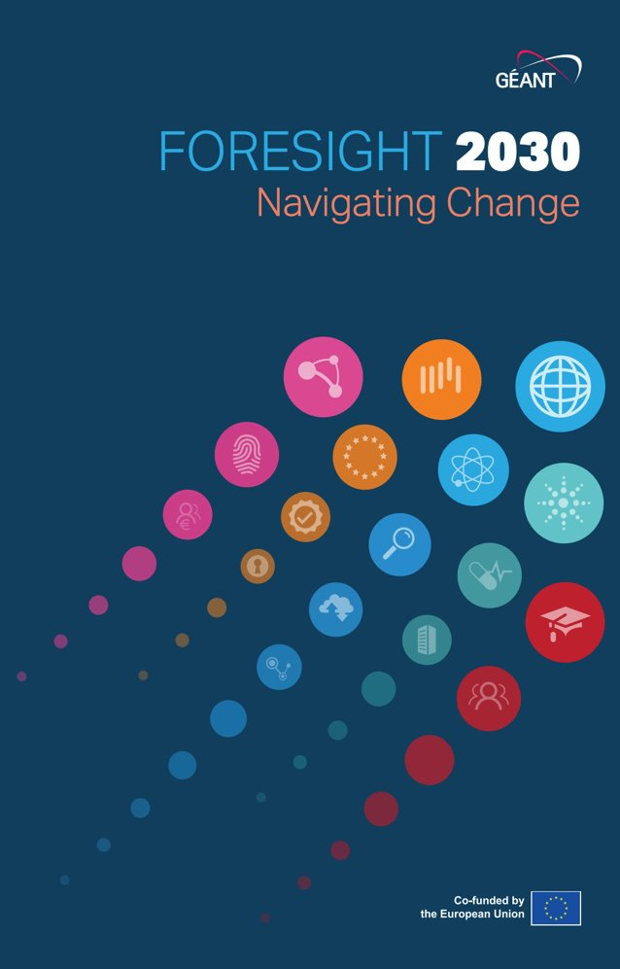
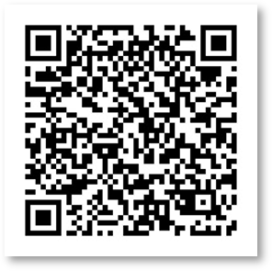
Navigating Change: Foresight 2030
Interaction with Commercial Actors – Navigating partnerships and competition with commercial service providers.
Climate Change and Sustainability – Addressing environmental responsibilities and the impact of climate policies.
Employment and Skills – Responding to evolving workforce needs and talent shortages.
Technological Advances – Keeping pace with innovation while ensuring interoperability and security.
NREN Governance – Adapting governance models to remain agile and effective.
Delivering Research and Education at Scale – Meeting the growing demand for digital infrastructure and services.
Notes:
We are not complacent about the future. Last year a major study was undertaken by GÉANT and representatives of a range of NRENs to try to determine how best NRENs can prepare for the future.
From over 50 potential challenges, the expert working group distilled them into six core areas
(slide text)
- for Climate change – reference recent weather events in Spain
– for Employment and Skills – can reference the challenges for public institutions in remaining competative employers
I’d very much recommend you follow the QR code, or find the report on our website to read the report for yourselves, and to think about how your organisation is preparing for the challenges of the future.

Slide 37
GÉANT’s strategic goals
Notes:
Looking to the future, the foundation of my speech here today, has been the key tenents of GÉANT’s strategy, grounded in our core values.
However, that stratgy is being updated, and as we move from the “listening” into the “formulating” stage, we will be drawing on contributions from all our members, seeking alignment with our member NREN’s strategies, and looking to the future.
Europe is also changing, with new priorities and pressures which we must all face together if we are to best serve the education and research community.
One thing I am certain of though, is that COMMUNITY, and our values of TRUST, INNOVATION, and PASSION, will continue to be central to all we do.
I hope that my presentation today has celebrated the shared work of over 3 decades, of RedIRIS and GÉANT, and sparked some ideas of how you you all can make the most of the benefits of your GÉANT membership in the years to come.

Slide 38
Thank You
Any questions?
www.geant.org
Notes:
Thank you, and enjoy the rest of this fabulous conference!

